Slide 1
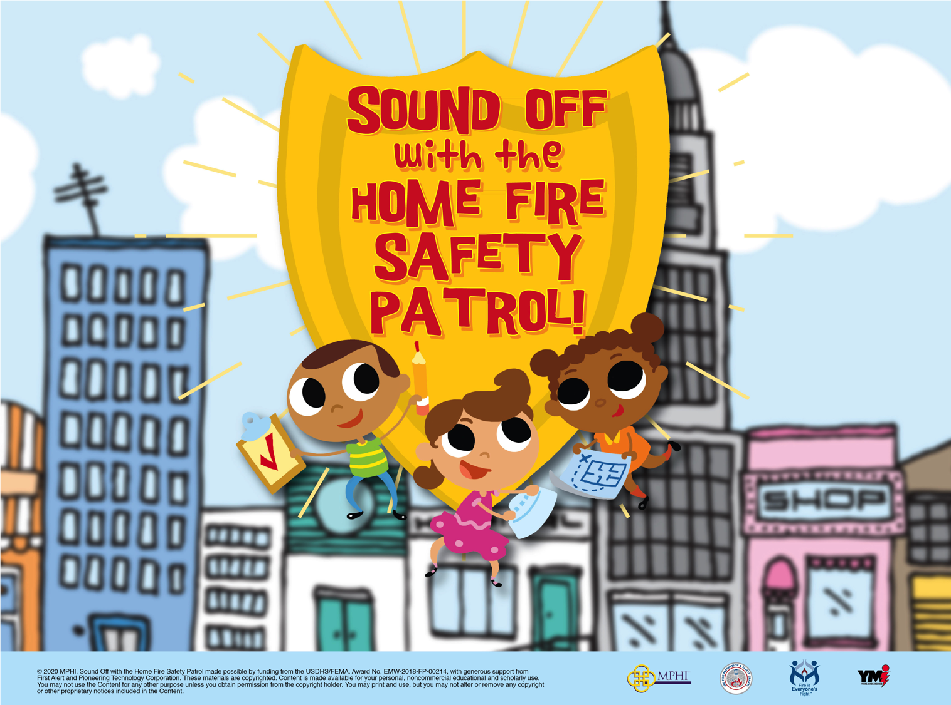
© 2022 MPHI. Sound Off with the Home Fire Safety Patrol made possible by funding from the USDHS/FEMA, Award No. EMW-2020-FP-00010, with generous support from First Alert and Pioneering Technology Corporation. These materials are copyrighted. Content is made available for your personal, noncommercial educational and scholarly use. You may not use the Content for any other purpose unless you obtain permission from the copyright holder. You may print and use, but you may not alter or remove any copyright or other proprietary notices included in the Content.

Slide 2
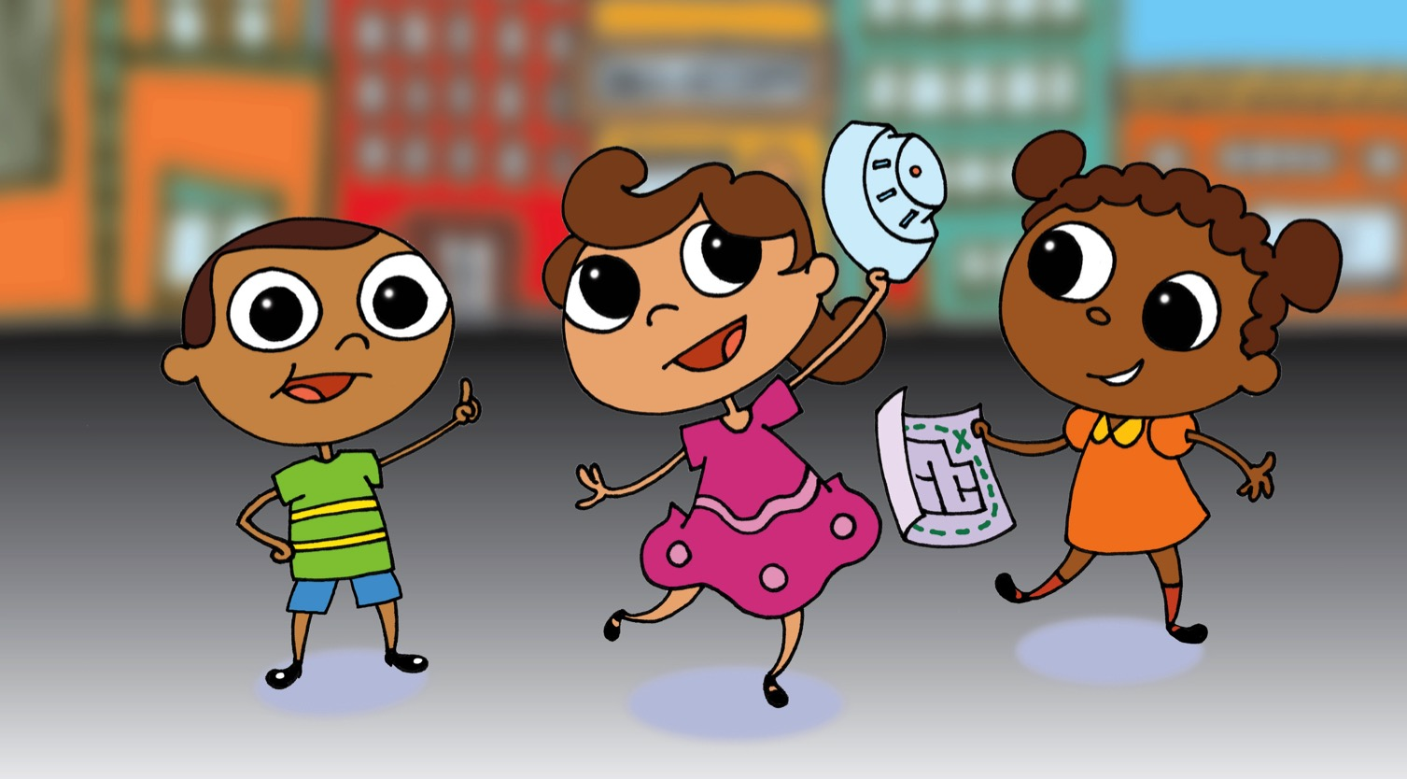
Meet the Home Fire Safety Patrol.
“We help families stay safe from fire,” said Pablo.
“With smoke alarms!” said Sofia.
“And a home fire escape plan!” said Ana.

Slide 3
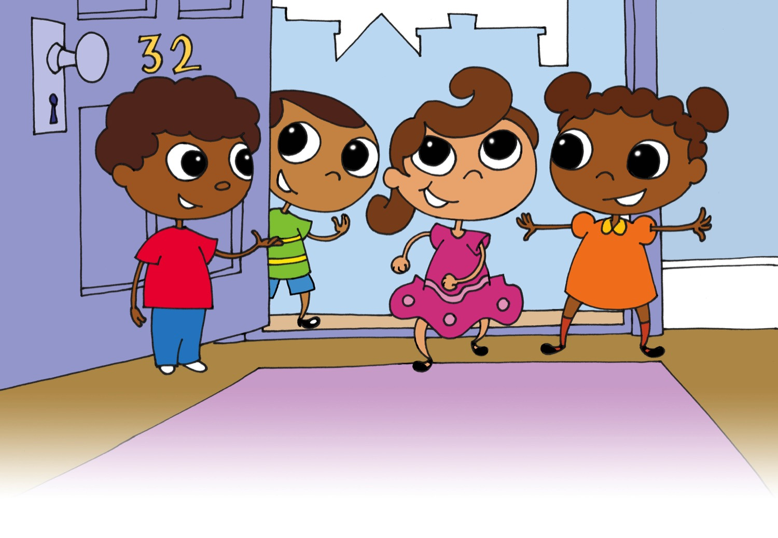
Today the Safety Patrol is visiting Marco’s home.
“Let’s start by looking for smoke alarms,” said Sofia. “They make a loud noise when a fire starts. So you have time to get out fast!”

Slide 4
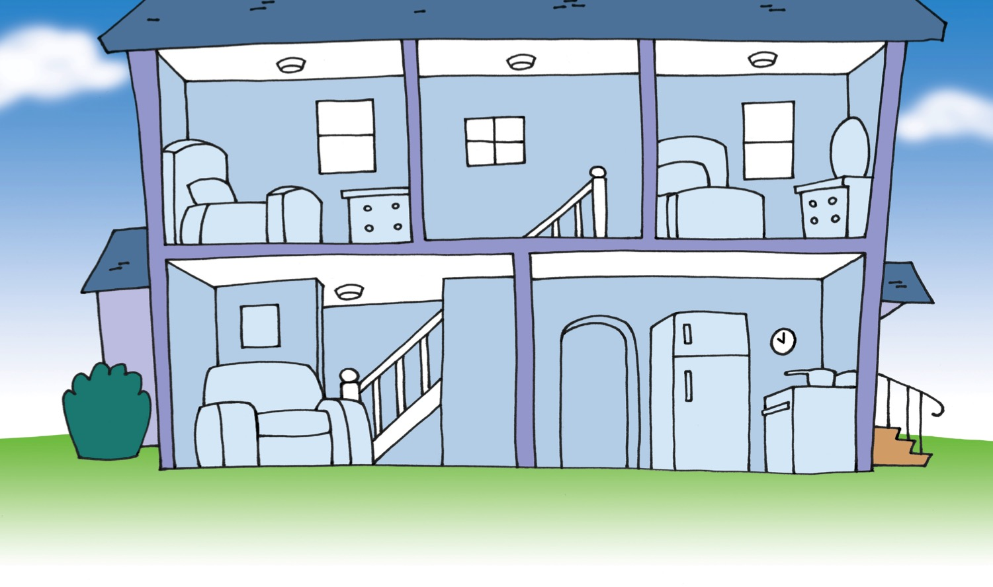
“You need at least one smoke alarm on each level of your home,” said Ana. “That is so you can hear the alarm in every room.”
“You need a smoke alarm in every bedroom. You need a smoke alarm in other rooms where people sleep, too,” said Pablo. “The noise will wake you if a fire starts when you are sleeping.”
Can you find the smoke alarms in Marco’s home? Does his home have one on every level?

Slide 5
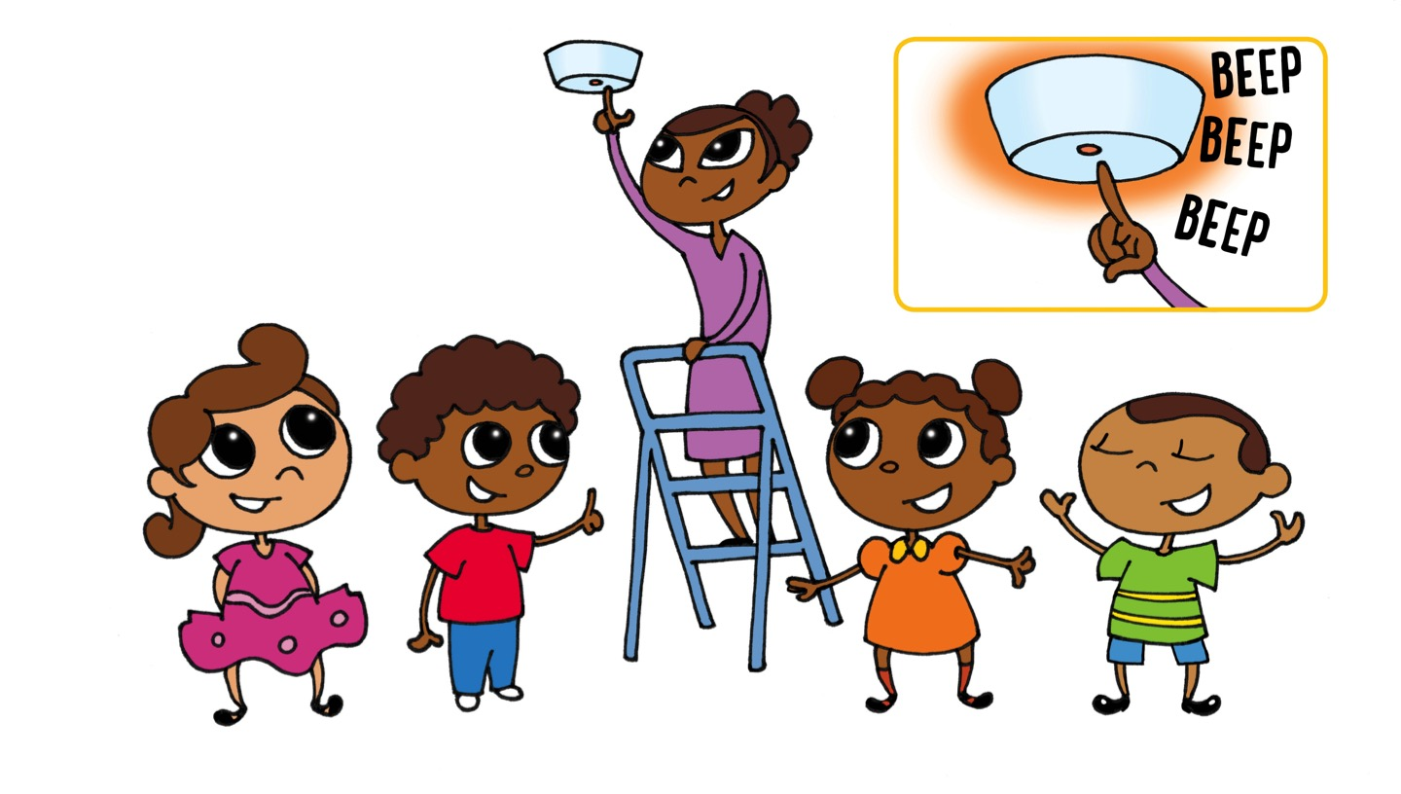
“Do you test your smoke alarms every month?” asked Sofia.
“Yes,” said Marco. “My mom is testing them today!”
The Safety Patrol went to each room with Marco’s mom. When Marco’s mom pushed the test button, they heard a loud BEEP-BEEP-BEEP!
“That sound means the smoke alarm is working,” said Ana. “That is the sound you will hear if there is a fire.”

Slide 6
“I have heard a smoke alarm make a CHIRP noise. It was like a bird,” said Marco. “What does that sound mean?”
“It means that the battery is old,” said Sofia. “A smoke alarm says CHIRP when it needs a new battery.”
“It can also mean that your smoke alarm is old,” said Ana. “If you hear CHIRP, put in a new battery or get a new smoke alarm.”

Slide 7
Pablo said, “Before we go, let’s practice what to do when you hear a smoke alarm go BEEP-BEEP-BEEP!”
“That sound means there is a fire,” said Marco. “We have to get outside fast!”
“Very fast,” said Pablo. “Everyone should be able to get outside in less than 3 minutes.”
“That is why you need a home fire escape plan,” said Ana. “Make a map that shows two ways out of every room in your home. Then you can get out fast, wherever a fire starts. Draw your outside meeting place. You can call 9-1-1 from there and tell them your street address.”

Slide 8
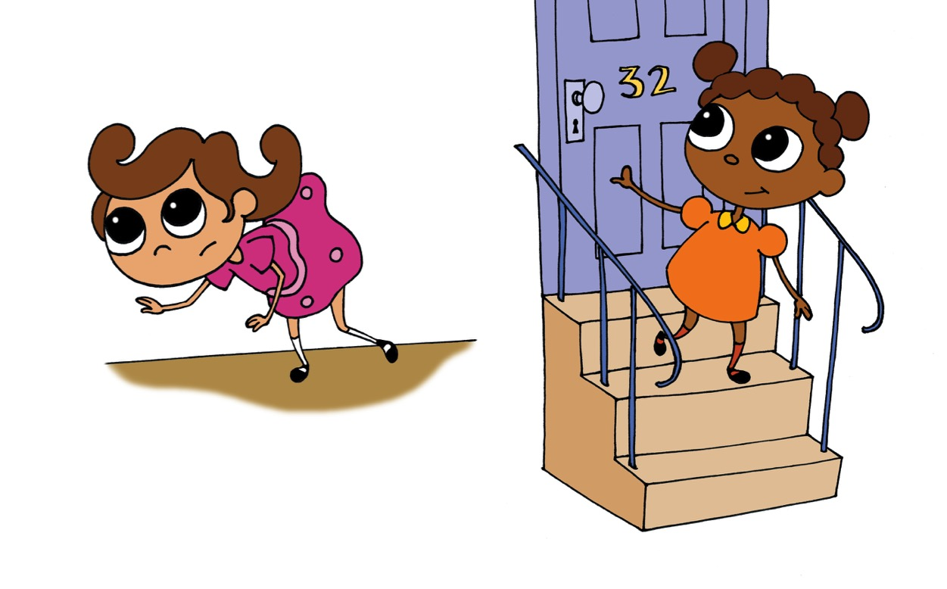
The Home Fire Safety Patrol helped Marco draw a home fire escape map for his home. Then they had a fire drill to practice the plan.
“GET LOW AND GO if you see smoke when you are escaping a fire,” said Sofia. “Smoke rises. When you stay low, you are breathing the clean air close to the floor.”
“Get out fast! Close the door behind you,” said Ana. “Go to your outside meeting place!”

Slide 9
“We made it outside in less than 3 minutes,” said Pablo. “That is great!”
“Your family should practice your escape plan twice a year,” said Ana. “The more you practice, the faster you can get outside to safety if there is a fire.”
“Once you get outside, never go back into a burning home,” said Sofia. “It is too dangerous! Call 9-1-1 and wait for the firefighters. They will know what to do.”
“Thanks,” said Marco. “I have learned a lot about home fire safety today.”
What have you learned about home fire safety? Tell your family how to make your home safe.

Slide 10
1. What sound does a smoke alarm make when there is smoke in your home?
Answer:
Answer: A smoke alarm goes BEEP-BEEP-BEEP… BEEP-BEEP-BEEP when there is smoke in a home.

Slide 11
2. What does it mean when a smoke alarm makes a chirping sound?
Answer:
Answer: That sound means the smoke alarm needs new batteries or it’s time to get a new smoke alarm.

Slide 12
3. What should you do when the smoke alarm goes BEEP-BEEP-BEEP?
Get Low and Go if you see smoke
Get to your outside meeting place as fast as you can
Once outside, stay outside — NEVER go back into a burning building
All of the above
Answer:
Answer: d. All of the above

Slide 13
© 2022 MPHI. Sound Off with the Home Fire Safety Patrol made possible by funding from the USDHS/FEMA, Award No. EMW-2020-FP-00010, with generous support from First Alert and Pioneering Technology Corporation

Slide 14
Special Thanks!
Jeremy Berger
Fire and Life Safety Educator
Saint Paul (MN) Fire Department
Lt. Annmarie Pickett
Worcester (MA) Fire Department

