Slide 1

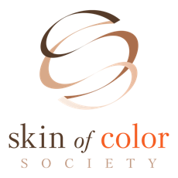

Career Spotlight: Dermatology
© 2024 YMI, Inc.
This program, brought to you by Young Minds Inspired, is part of Pathways: Inclusivity in Dermatology. Thank you to the Skin of Color Society for contributing images to this program.
Notes:
The notes in this presentation feature information and talking points to share with students to support the Skin Science program.

Slide 2

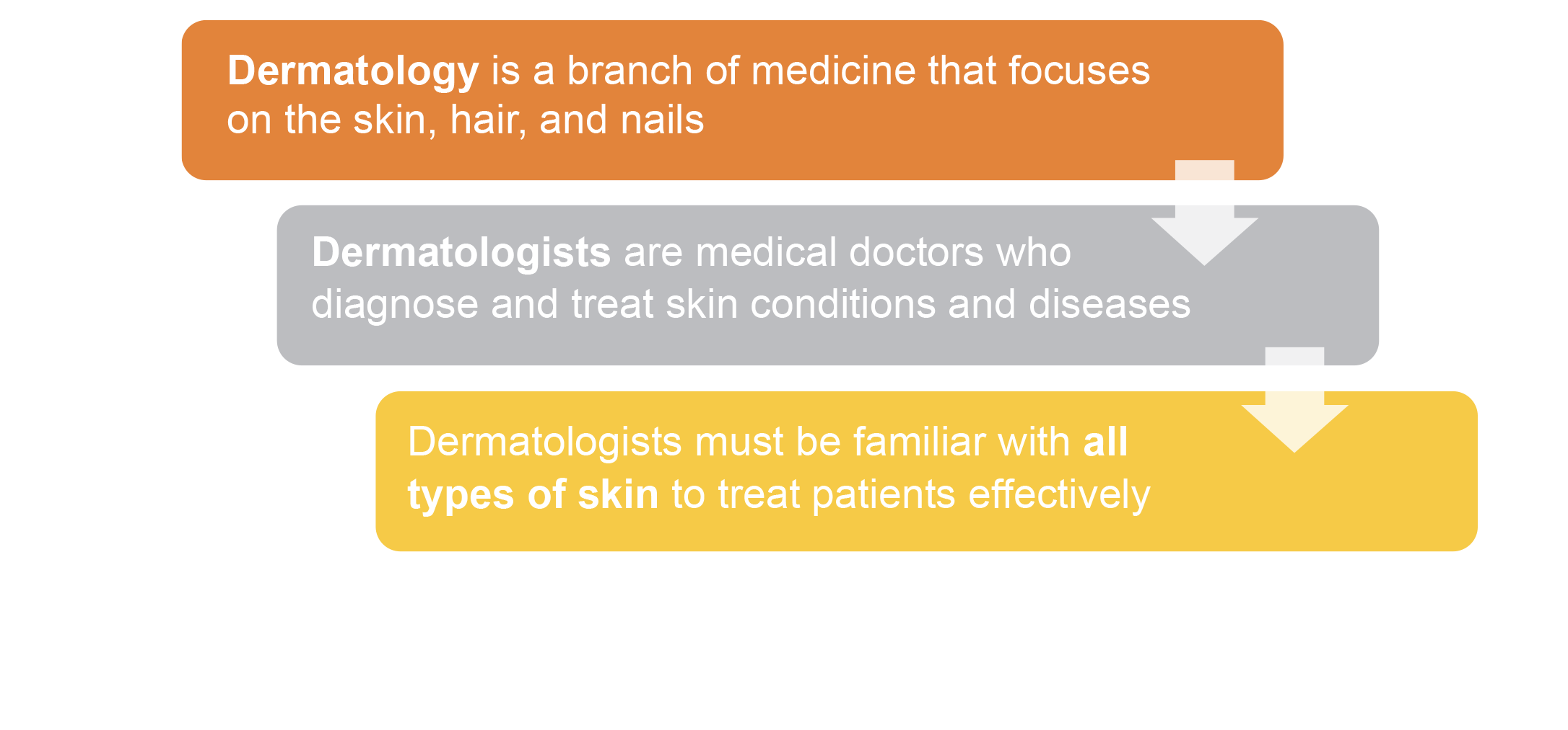

What is Dermatology?
Notes:
Define dermatology and point out that dermatologists treat more than 3,000 disorders and diseases, including acne, athlete’s foot, dandruff, and more.
Emphasize that the functions of the skin are the same for all people, but there is diversity within skin tones and skin types that affect skincare and how conditions present themselves.
Dermatologists understand that a skin condition can have a serious impact on a person’s health and overall quality of life.

Slide 3

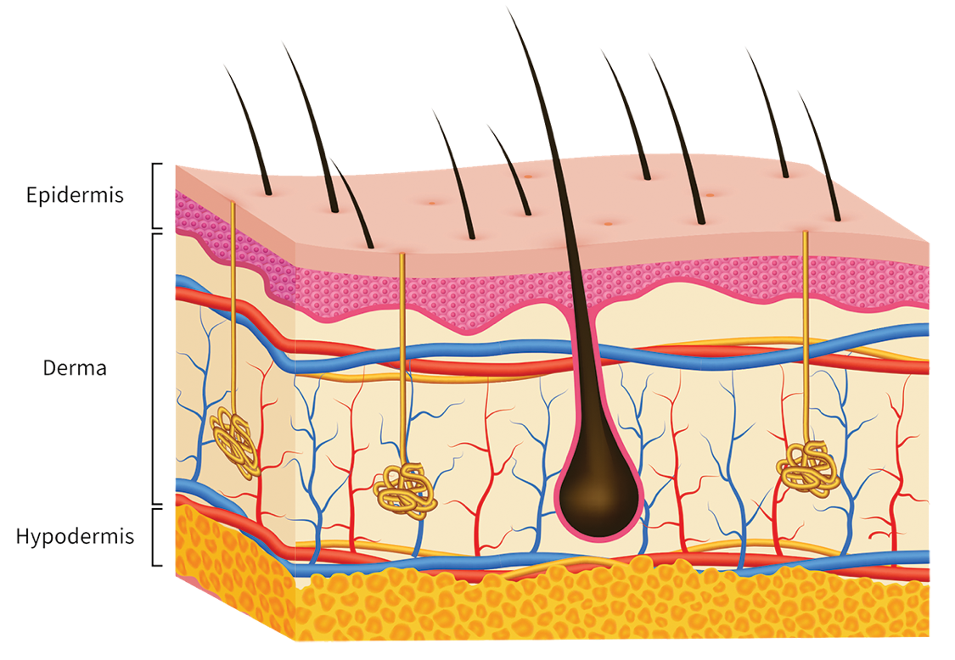
Three layers of skin
Epidermis → outer protective
barrier, creates skin cells, provides
skin color (melanin)
Dermis → grows hair, enables
touch, makes oil, produces sweat, supplies blood to the epidermis
Hypodermis → cushions muscles
and bones, regulates body
temperature
Did You Know?
Underlying health issues can show up on the skin!
Notes:
Explain that:
Skin is the largest organ of the human body.
Although people often think of skin in terms of the outermost layer, it is a multi-layered organ and performs many vital functions.
Point to and review the 3 main layers of the skin and their corresponding functions.
When reviewing epidermis, explain that more melanin = darker skin; less melanin = lighter skin
Emphasize that underlying health issues can show up on the skin in the epidermis. For example, issues with kidney, liver, and immune system.
Kidney and liver diseases can be indicated by discoloration of the skin (yellow or gray depending on cause).
Immune diseases can cause rashes, blisters, lesions, or other visible irritation depending on the type of disease.

Slide 4
Fitzpatrick Skin Type Classification*
Skin type | Typical features | Tanning ability
I | Pale white skin, blue/green eyes, blond/red hair | Always burns, does not tan
II | Fair skin, blue eyes | Burns easily, tans poorly
III | Darker white skin | Tans after initial burn
IV | Light brown skin | Burns minimally, tans easily
V | Brown skin | Rarely burns, tans darkly easily
VI | Dark brown or black skin | Never burns, always tans darkly
* Skin phototype (Fitzpatrick skin type) | DermNet (dermnetnz.org)
Notes:
Point out that there are different types of scales used to classify skin types.
The Fitzpatrick Scale classifies skin based on its reaction to sun exposure.
Different amounts of melanin affect how dark or light skin color is.
Skin conditions present with varying frequency depending on the skin type of the patient. This example compares top common diagnoses in Black and White patients.
TRANSITION: The next series of slides will focus on common skin conditions that dermatologists diagnose and treat.

Slide 5

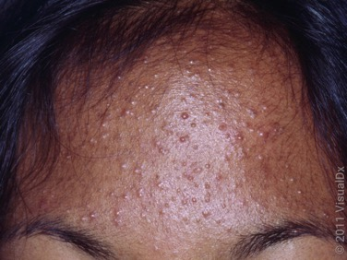
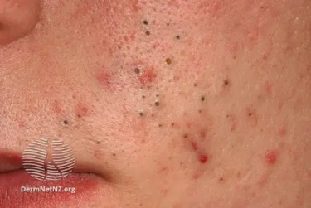
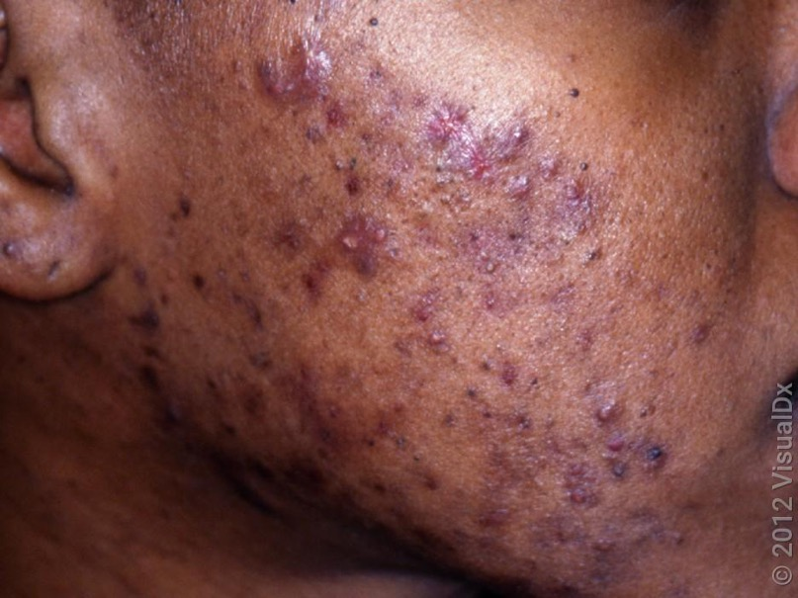
Acne
Signs and symptoms:
Whiteheads, blackheads
Pimples (white or flesh-colored bumps)
Nodules and/or cysts (deep and painful bumps)
Treatment:
Topical medications; Rx antibiotics
Laser or light therapy; corticosteroid injections
Address acne scars and hyperpigmentation
Image used with permission from VisualDx (www.visualdx.com).
Image used with permission of DermNetNZ.
Image used with permission from VisualDx (www.visualdx.com).
Notes:
Explain that acne develops when pores become clogged with oil (sebum) and/or dead skin cells, causing breakouts.
Acne often develops in teenagers due to hormonal changes that lead to increased oil production, which can clog pores.
Whiteheads and blackheads are caused by pores clogged with oil and dead skin cells.
Pimples are caused by excess oil, dead skin cells, and bacteria being trapped in pores → mild to moderate inflammation, creates swelling, which is the pimple.
Nodules and cysts are caused by pores filled with excess oil, dead skin cells, and bacteria → inflammation that goes deep into skin.
NOTE: Hyperpigmentation associated with inflammatory response can be significant in patients of color.
TREATMENT
Most mild to moderate cases of acne are treated with topical medications (applied directly to skin)
More severe cases may require laser or light therapy or corticosteroid injections to relieve pain and reduce size of breakout
6 at-home acne tips from dermatologists [Presenter can show this site to students]

Slide 6
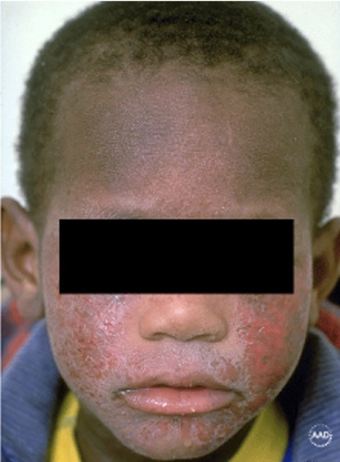
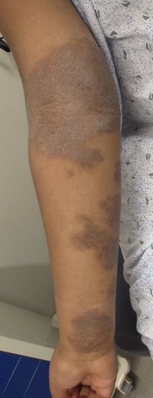
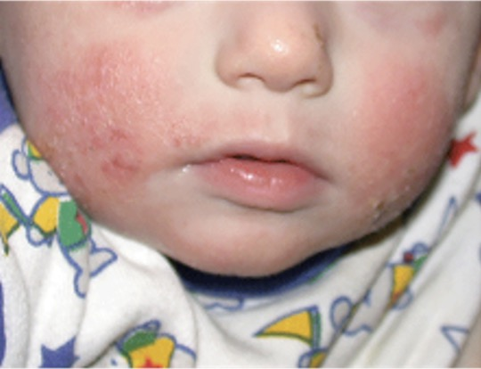
Atopic Dermatitis (Eczema)
Signs and symptoms:
Itchy skin that develops into a rash
Raw, cracked, irritated skin that may bleed
Oozing, blister-like lesions that may become scaly or crusted
Treatment:
Keep skin moisturized with fragrance-free creams and ointments
Topical and systemic anti-inflammatory medications
Image used with permission from Skin of Color Society.
Image used with permission from American Academy of Dermatology.
Image used with permission from Derm-Net NZ
Notes:
Explain that eczema refers to a group of inflammatory conditions that causes dry, itchy, and inflamed skin.
Cause: the immune system has a reaction to an allergen (i.e., pollen, dander)
Eczema can be caused by genetics (runs in families) and environmental influence. Flare-ups can come and go for years.

Slide 7

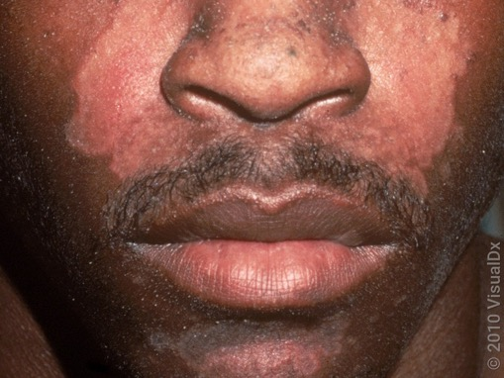
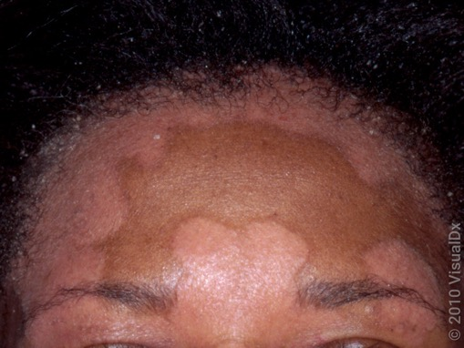
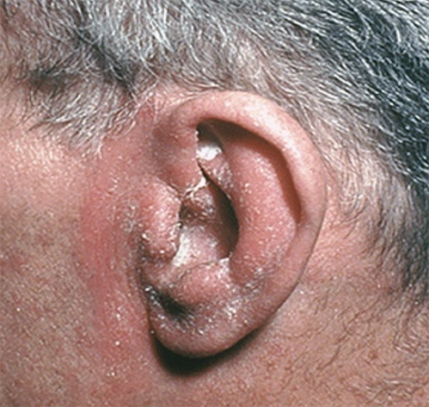
Seborrheic
Dermatitis
Signs and symptoms:
A scaly rash, inflamed skin, flaking
Mainly affects scalp
Can be found on ears, eyebrows, beard, chest hair, nostrils
Treatment:
OTC anti-dandruff/anti-fungal shampoo
Rx topical medications to reduce inflammation
Image used with permission from VisualDX (www.visualdx.com).
Image used with permission from VisualDX (www.visualdx.com).
Image used with permission from
American Academy of Dermatology.
Notes:
Explain that seborrheic dermatitis is a common inflammatory response to natural oil produced on the scalp and other oily regions.
When a baby has seborrheic dermatitis, it usually appears on the scalp and is called cradle cap.
In the U.S., Black people are most likely to develop this condition.
Lighter skin tones tend to exhibit a red, raised rash (top). On darker skin tones, the rash looks lighter than the surrounding skin (bottom).
In darker skin tones, seborrheic dermatitis can also cause dark spots and patches on the skin.

Slide 8

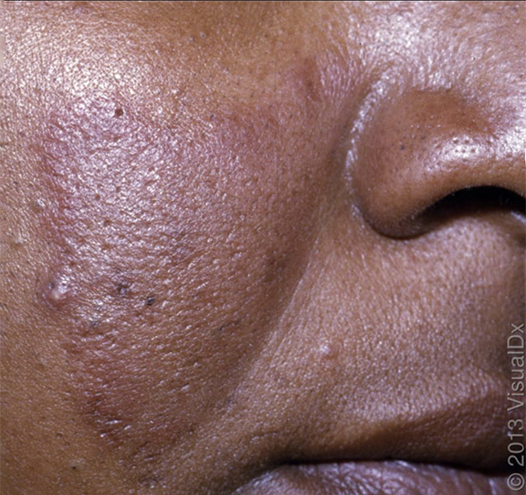
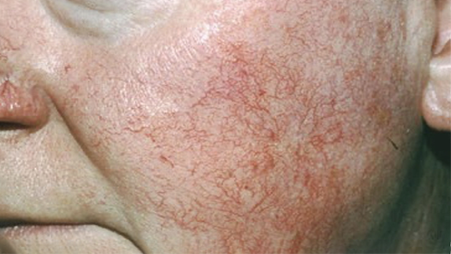
Rosacea
Signs and symptoms:
Affects skin on the face and sometimes the eyes
Tendency to blush easily; visible broken blood vessels
Pimple-like breakouts but no blackheads
Treatment:
Gentle skincare and identify triggers to prevent flare-ups
Topical and oral medicine and/or laser treatment
Image used with permission of VisualDX (www.visualdx.com).
Image used with permission of American Academy of Dermatology.
Notes:
Explain that rosacea is a chronic condition. There is no cure, but there are ways to control it.
Rosacea is underdiagnosed in skin of color.
Emphasize that when people with darker skin tones develop rosacea, early symptoms (flushing) can be overlooked or mistaken for another condition.
Triggers can include eating spicy food, direct contact with cold wind, and becoming overheated.

Slide 9
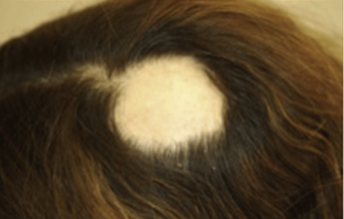
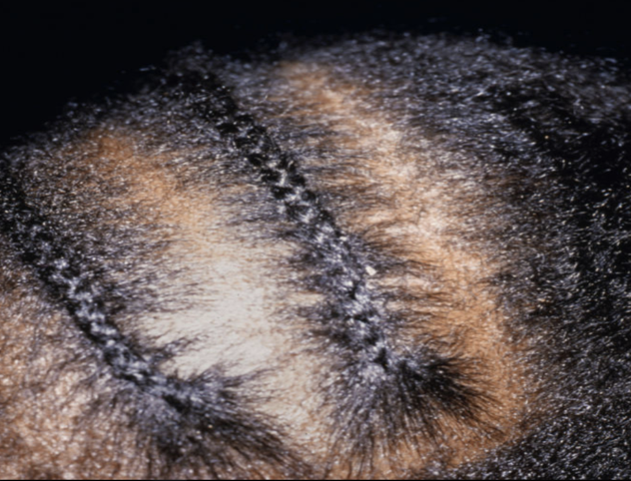
Alopecia
Signs and symptoms for ALOPECIA AREATA (top):
Hair loss usually begins on the scalp or the beard
Patches may be noticeable or small and hidden
Signs and symptoms for TRACTION ALOPECIA (bottom):
Breakage caused by tight pulling on edges of hair
Tingling sensation on crown of scalp
Treatment:
Seek treatment early; limit particularly
tight hair practices
Topical medication or steroid injections
to promote regrowth
Images used with permission of American Academy of Dermatology.
Notes:
Explain that alopecia is an autoimmune disease that causes hair loss. There are many different types. It can also cause hair loss on eyebrows and/or eyelashes.
Early diagnosis is key!
Traction alopecia is caused by repetitive and excess tension on edges of hair (tight pulling due to ponytails, braids, weaves, etc.)
Underrecognized culprits: sleeping bonnets/scarves, wig caps, rubber bands
Initially reversible, but over time can cause scarring
This condition may also be an early sign of folliculitis (when a hair follicle becomes inflamed or infected).
Higher risk: hair that is relaxed in combination with tighter hair styles

Slide 10

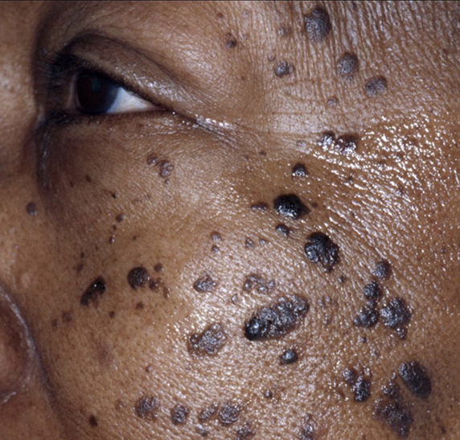
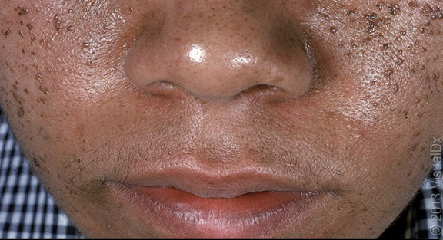
Dermatosis papulosa nigra (DPN)
Signs and symptoms:
Small dark flat bumps on cheeks and temples
Usually appears during adolescence
Treatment:
Bumps are harmless; benign removal
Snip excision with scissors
Images used with permission from Skin of Color Society, DermNetNZ, American Academy of Dermatology.
Notes:
Dermatosis papulosa nigra (DPN) are harmless small, dark, flat bumps that can occur on the cheeks and temples of our skin as we age. DPNs are more common in women of color particularly Africans, Asians, and Latinos.
Dermatologists do not completely understand what causes these benign growths, but they most resemble another benign lesion called a Seborrheic Keratosis (SKs) which occurs in all skin types. DPNs are considered to be a variant of this.
Some patients refer to them as “flat skin tags” or “flat moles,” but they look and behave different from either of these growths. They tend to occur at an earlier age than SKs but can present with many of the same symptoms including itching when they first pop up.
DPNs tend to be more waxy appearing and “stuck on”.
Growths can be removed by a board-certified dermatologist to avoid side effects like hyperpigmentation, discoloration, and scarring.
DPNs, like other benign growths, can recur and you can continue to develop more. Maintenance treatments may be required.

Slide 11

Top ways to care for your skin
Apply sunscreen (SPF 30+) every single day.
Choose self-tanners over tanning beds.
Simplify your routine (cleanse + protect with sunscreen + moisturize).
Use products formulated for your skin type.
Protect your pout! Use lip products with SPF.
Keep your hands off your face.
Check your skin regularly for suspicious spots.
Watch: Skin care tips dermatologists use
Notes:
Watch the AAD video “Skin care tips dermatologists use” at https://www.youtube.com/watch?v=qkbWq7V3qIw
Review the skin care tips presented in the video.
Call attention to the characteristics listed for each skin type (sensitive, normal, dry, oily, or combination)
Emphasize that using too many products can easily irritate skin.
Sunscreen should be water-resistant, broad spectrum, and SPF 30+.
In some cases, dermatologists recommend that people with different skin tones take care of their skin in different ways.
If appropriate, refer to the “How to treat acne in skin of color” video at https://youtu.be/8yyshePMGEo?si=wFqwxaGQlUfw-Igq

Slide 12
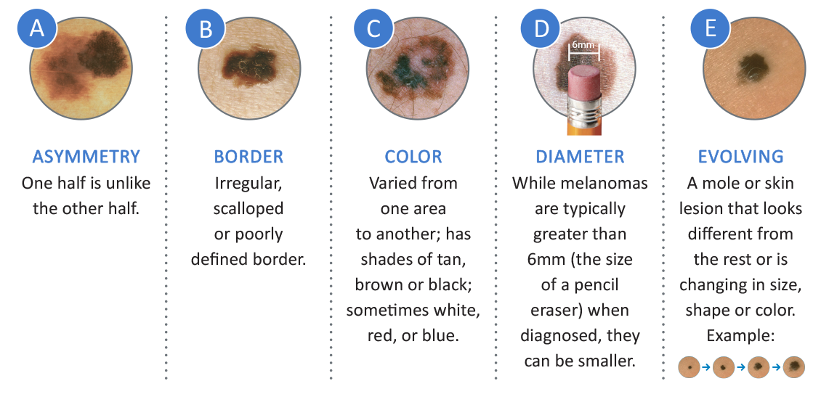
Know the ABCDEs of Melanoma
Melanoma is the deadliest form of skin cancer. However, when detected early, it can be effectively treated. Look for the following warning signs of melanoma when performing skin exams:
Watch: Find skin cancer: How to perform a skin self-exam
Images used with permission from Skin of Color Society, DermNetNZ, American Academy of Dermatology.
Notes:
Review the tips for conducting a skin self-exam to raise awareness about what to look for.
View the AAD video “Find skin cancer: How to perform a skin-self-exam” at https://www.youtube.com/watch?v=UnCUcFJJDSA

Slide 13

Know when to see a
Dermatologist
Acne that isn’t clearing up
Skin is dry, itchy, and irritated
A mole is changing in size or shape
Hair loss or noticeable bald spot
Rough, scaly patches on your body
Skin is often very red and flushed
Lighter or darker patches of skin
Notes:
Review the tips on when someone should see a board-certified dermatologist.

Slide 14

Building a career in dermatology
Dermatologists receive extensive specialized training before they are fully qualified to practice in their field.
Required education and training:
College bachelor’s degree (4 years)
Medical school (4 years)
Internship (1 year)
Residency (3 years minimum)
Board certification
Notes:
Move the discussion to dermatology careers.
Explain that to become a dermatologist requires:
A college degree, usually in a related field (biology, biochemistry, organic chemistry, health science)
Medical school, which provides comprehensive training and experience in general medicine to acquire an MD or DO degree
An internship, which is the first year of training after completing medical school. It is a chance to gain practical experience under the supervision of more experienced doctors.
A residency — newly graduated physicians complete specialized training focused on treating patients with skin issues.
Board-certification — doctors must pass an exam in both their specialty and subspecialty (if applicable); strengthens credentials

Slide 15

Specialized branches of dermatology
Dermatopathology: examine biopsy skin samples and pathology reports
Pediatric dermatology: work with children (newborns to adolescents)
Mohs surgery: perform skin cancer surgery
Notes:
Explain that there are subspecialties within dermatology that focus on specific patient demographics and/or types of procedures/treatments.
Review the specialized branches of dermatology, pausing to elaborate on each branch with the following details:
DERMATOPATHOLOGY: Dermatopathologists examine samples under a microscope; are called in when a dermatologist or primary care doctor wants to confirm an initial diagnosis
PEDIATRIC: All dermatologists treat children with skin conditions; specialists may be called upon in the case of severe disease, challenging birthmark, rare condition
MOHS SURGERY: Involves removing thin layers of skin one layer at a time and examining each layer until skin is cancer-free
COSMETIC: Common cosmetic procedures (not medically necessary) include chemical peels, laser surgery to diminish scars, hair transplants, and others

Slide 16
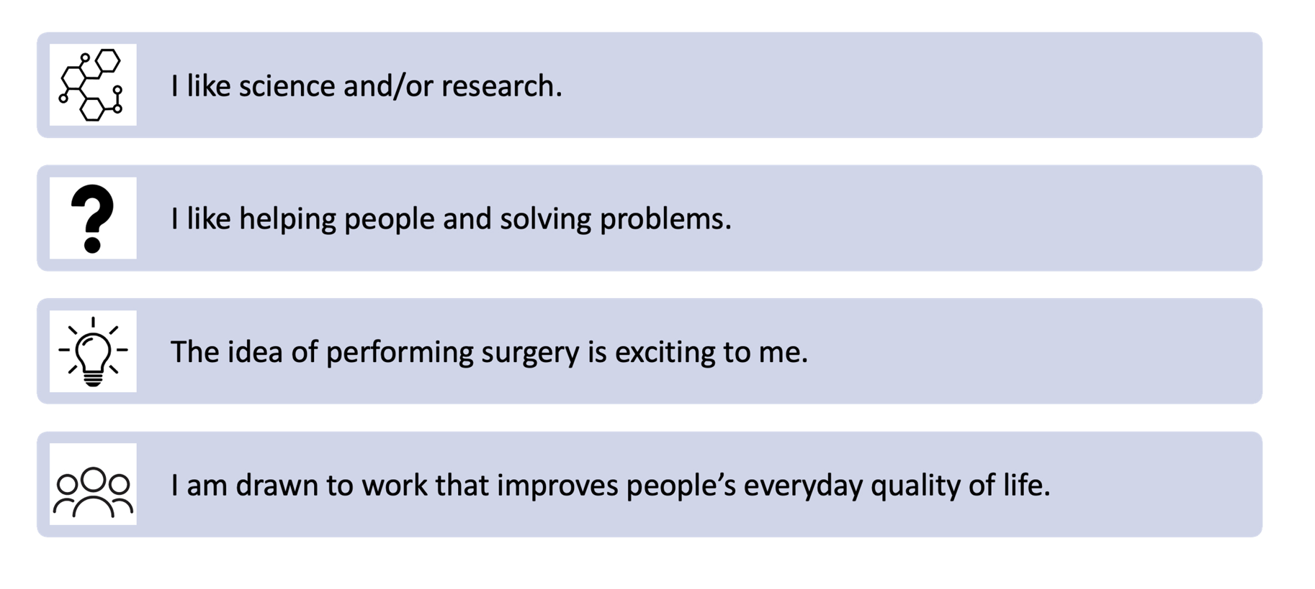
Is dermatology a good career match for me?
Notes:
Discuss the statements on the slide and ask students for their thoughts.

Slide 17

Career Spotlight: Dermatology
© 2024 YMI, Inc.
This program, brought to you by Young Minds Inspired, is part of Pathways: Inclusivity in Dermatology.

Slide 18

Optional Student Survey

