Slide 1
Fake Pharmaceuticals = Real Problems
Fake Pills: Myth vs. Fact
Find out the truth
about pills sold on
social media.
Brought to you by
© 2024 National Crime Prevention Council McGruff the Crime Dog®, “Take a Bite Out Of Crime®,”
“Go For Real™,” and “You’re Smart. Buy Smart.™” are trademarks of the National Crime Prevention Council.
© 2024 YMI, Inc.
SM
Notes:
[Presenter’s Note: How to Use the PowerPoint Presentation
This PowerPoint presentation is designed to be used by teachers and school nurses either as an introduction to the classroom materials or independently. It can be shown to students during class or as part of an after-school program, or it can be presented to parents and caregivers at school meetings by teachers or school nurses. To learn more about Fighting Fentanyl, visit the National Crime Prevention Council website at (New URL to come) before you begin. When you are done with your presentation, invite students to play the Think Again game at mcgruff.org/games/think-again to test their knowledge about counterfeit pills and other products.]

Slide 2
Fake pills and other counterfeit
products are a very real problem.
Let McGruff show you why.

Slide 3
Ready to learn more about
the dangers of fake pills?
Don’t fall for these myths —
get the facts!

Slide 4
Myth #1
Because they look the same,
fake pills will work the
same as real ones.

Slide 5
Fact:
Fake pills often look identical to legitimate prescription pills. They can be the same
size, with the same colors and markings.¹ Tragically, many young people are
fooled into death as a result.
¹ https://www.dea.gov/sites/default/files/2021-05/Counterfeit%20Pills%20fact%20SHEET-5-13-21-FINAL.pdf
image: https://www.dea.gov/onepill/images

Slide 6
Myth #2
Even if a pill is fake,
it won’t hurt you to
take just one.

Slide 7
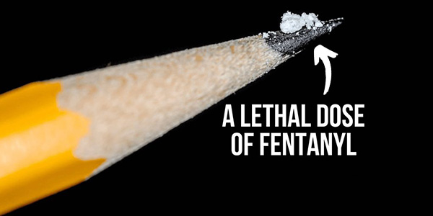
Fact:
Many fake pills contain a lethal dose of
fentanyl, a very strong synthetic opioid
used to treat severe pain. Fentanyl is so strong that a very small dose — like the amount that can fit on the tip of a pencil — can
be deadly.² It only takes one pill!
² https://www.dea.gov/sites/default/files/2021-05/Counterfeit%20Pills%20fact%20SHEET-5-13-21-FINAL.pdf

Slide 8
More Facts:
If you don’t get a prescription filled at a licensed pharmacy, you won’t know what kind of pill you’re actually getting.
Real pharmaceutical companies spend time and money to ensure every pill has the right amount of tested ingredients.
Criminals don’t do the same. They make pills themselves and don’t care if what you’re getting is safe.
.

Slide 9
Myth #3
Fake pills aren’t that common.
It’s not a real problem.

Slide 10
Fact:
Think again!
Fentanyl is now involved in at least
75% of adolescent overdose deaths.
In 2022, this averaged to 22 adolescent
overdose deaths involving fentanyl
each week in the U.S. according to data
from the CDC.³ Drug overdose is now the
leading cause of death for teens
and young adults.⁴
That’s a real problem.
3 Joseph Friedman, Ph.D.. M.P.H., and Scott E. Hadland, M.D., M.P.H., “The Overdose Crisis Among U.S. Adolescents.” (January 11, 2024) N Engl J Med 2024: 390:97-100. DOI: 10.1056/NEJMp2312084
4 https://www.ncpc.org/fighting-fentanyl-2/

Slide 11
Be Smart, Be Safe
Be smart: If someone offers you medication, online or in person, think again!
Be aware: Learn about the dangers of fake pills and the threat of fentanyl.
Be safe: Only purchase and use medicines prescribed to you by a doctor and obtained at a licensed pharmacy.
Be in the know: Visit ncpc.org/goforreal to learn more about the dangers of fakes.

Slide 12
Don’t Be Fooled!
Share what you’ve learned about
the dangers of purchasing fake pills
online — and the deadly risk of
fentanyl — with family and friends.
Help keep yourself and the
people around you safe.
SM
Notes:
Presenter’s note: Invite students to play the Think Again game at mcgruff.org/games/think-again to test their knowledge about counterfeit pills and other products.

