Slide 1

:
© 2026 MPHI. Sound Off with the Home Fire Safety Patrol made possible by funding from the USDHS/FEMA, Award No. EMW-2024-FP-00140, with generous support from First Alert. These materials are copyrighted. Content is made available for your personal, noncommercial educational and scholarly use. You may not use the Content for any other purpose unless you obtain permission from the copyright holder. You may print and use, but you may not alter or remove any copyright or other proprietary notices included in the Content.
Notes:
Welcome to the “Sound Off with the Home Fire Safety Patrol” program.
Presenter Note: Introduce yourself and provide other introductions as appropriate.

Slide 2
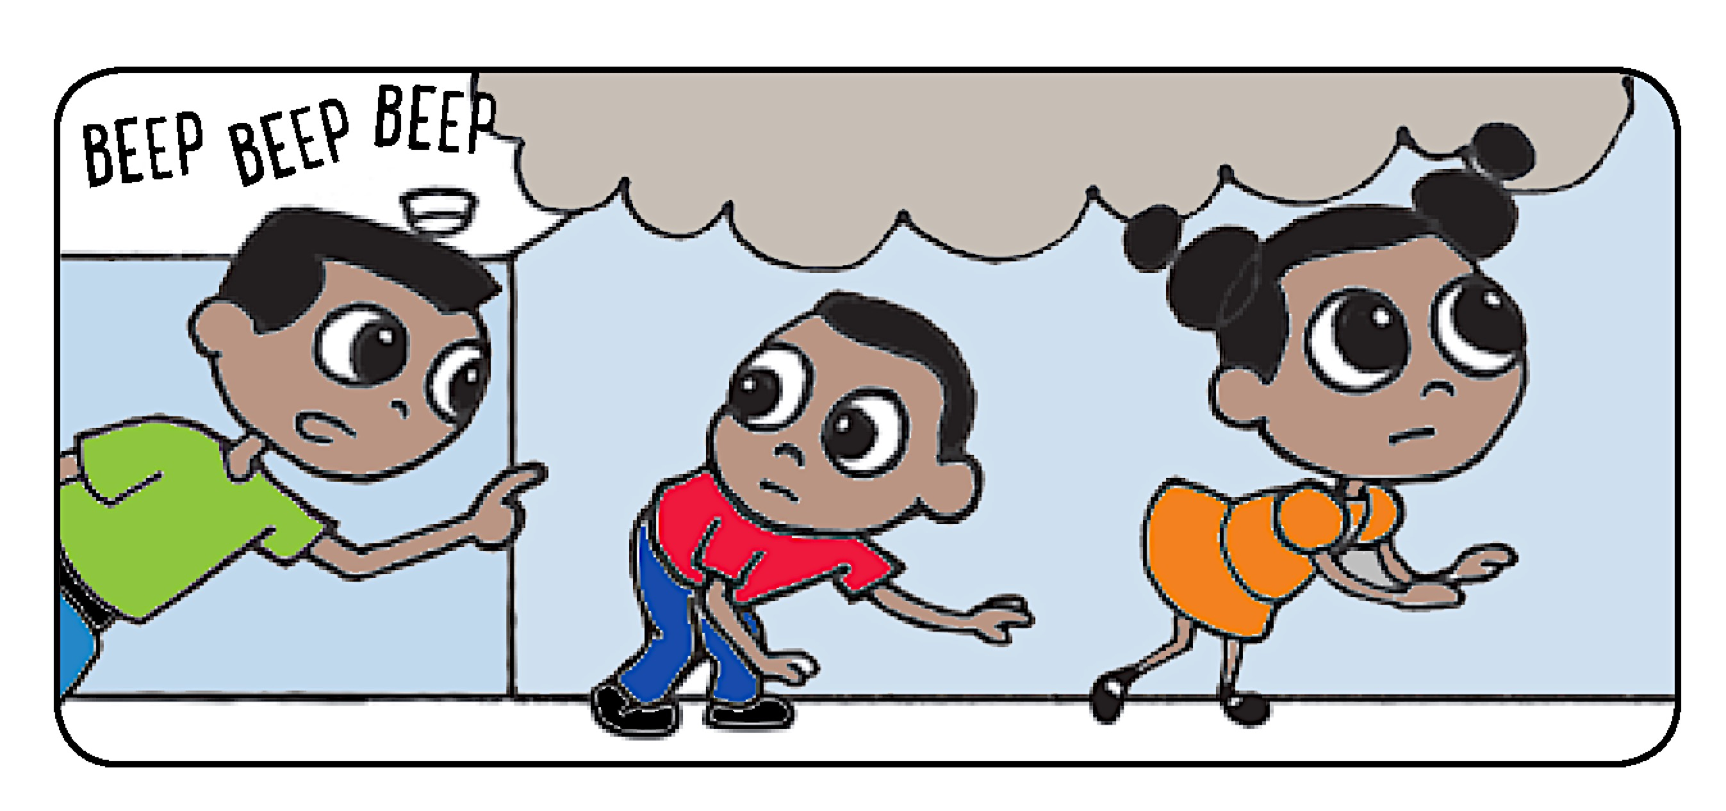
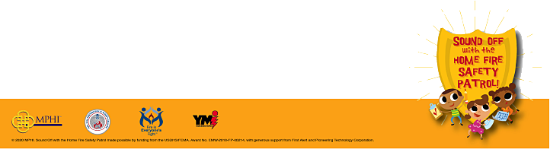
What Grown-ups
Need to Know About the
Sound Off with the
Home Fire Safety Patrol
Program
Working Smoke Alarms Save Lives in a Fire!
© 2026 MPHI. Sound Off with the Home Fire Safety Patrol made possible by funding from the USDHS/FEMA, Award No. EMW-2024-FP-00140, with generous support from First Alert.
Notes:
The purpose of this presentation today is to share with you the valuable Sound Off lessons being taught to children and everyone in the community; and to emphasize your role in supporting these important fire safety practices.
Presenter Note: Identifies the goal of the presentation.

Slide 3
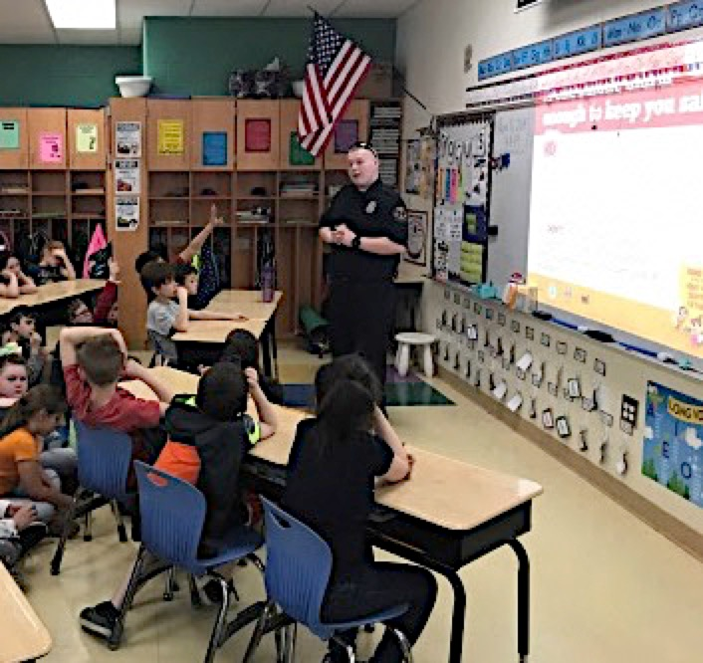
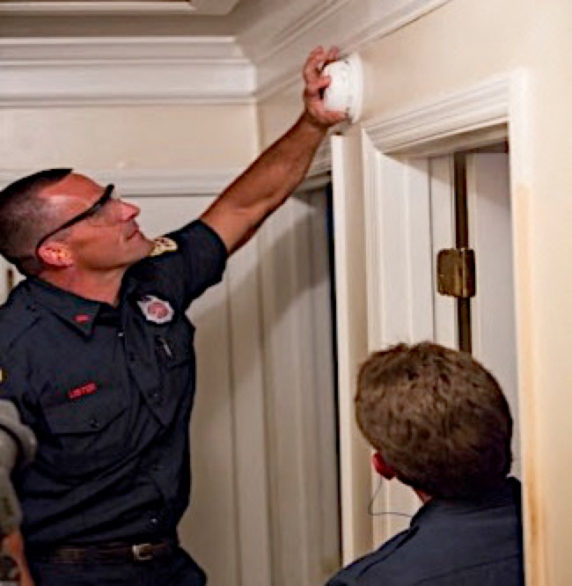
Working Smoke Alarms Save Lives in a Fire!
Sound Off with the Home Fire Safety Patrol
combines:
• Classroom learning for grades 2 and 3
• Home safety visits to install alarms
:
© 2026 MPHI. Sound Off with the Home Fire Safety Patrol made possible by funding from the USDHS/FEMA, Award No. EMW-2024-FP-00140, with generous support from First Alert.
Notes:
Working smoke alarms save lives when there’s a fire because they warn you early! This has been proven again and again. Together with a home fire escape plan and home fire drills, they can help families safely escape a home fire.
The “Sound Off with the Home Fire Safety Patrol” program combines classroom learning for grades 2 and 3 with home safety visits from firefighters to check and/or install working smoke alarms.
Presenter Note: Identifies the goals of the Sound Off program.

Slide 4
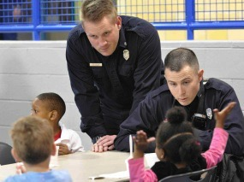
Firefighters in Schools
© 2026 MPHI. Sound Off with the Home Fire Safety Patrol made possible by funding from the USDHS/FEMA, Award No. EMW-2024-FP-00140, with generous support from First Alert.
Notes:
Children love it when firefighters visit their classrooms! It leaves a lasting impression. Sound Off teaches children about the need for working smoke alarms, the sounds smoke alarms make, and what to do when they hear those sounds. It also teaches children how to work with the grown-ups in their lives to find and correct fire dangers in their homes and what to do when there’s a fire.
Presenter Note: Expand with your personal experiences in the classroom if possible.

Slide 5
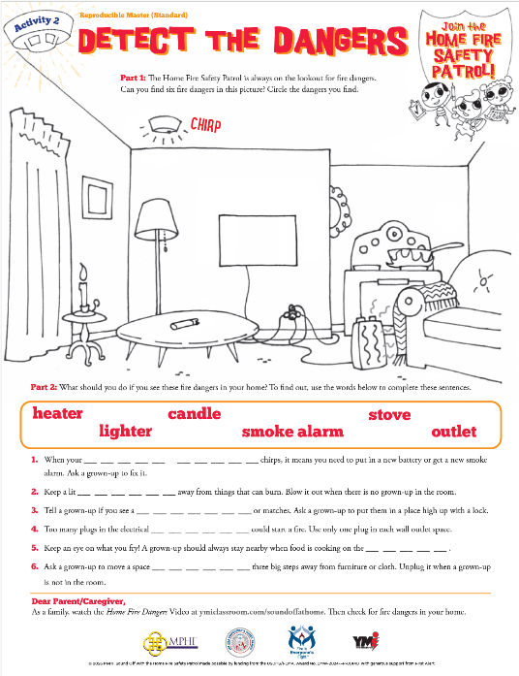
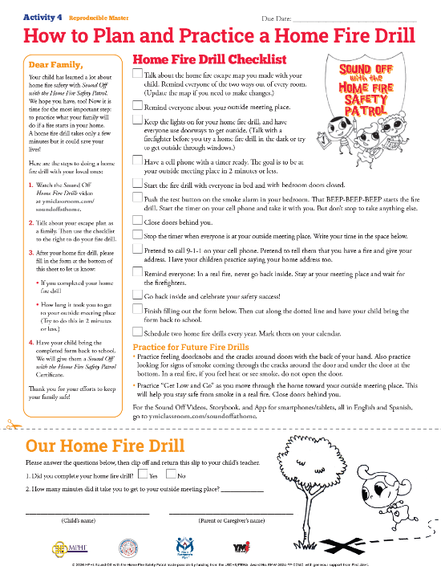
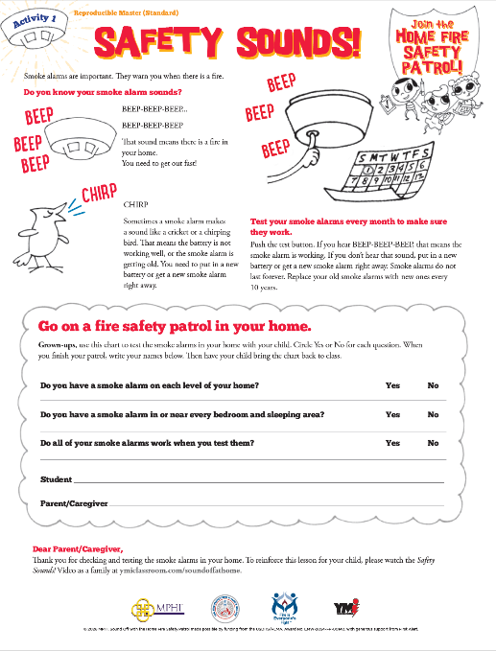
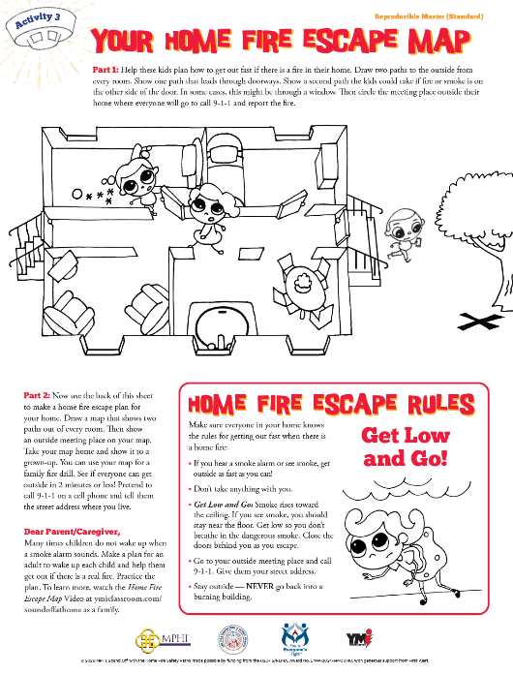
Teach Lifesaving Lessons
Smoke Alarm Sounds - Home Fire Dangers
Home Fire Escape Maps - Home Fire Drills
© 2021 MPHI. Sound Off with the Home Fire Safety Patrol made possible by funding from the USDHS/FEMA, Award No.EMW-2019-FP-00083, with generous support from First Alert and Pioneering Technology Corporation.
© 2026 MPHI. Sound Off with the Home Fire Safety Patrol made possible by funding from the USDHS/FEMA, Award No. EMW-2024-FP-00140, with generous support from First Alert.
Notes:
The Sound Off program presents four lifesaving lessons for children:
The first lesson teaches that every home should have working smoke alarms. Smoke alarms make a loud Beep-Beep-Beep if there is a fire in your home and give you time so you wake up and can get to a safe place outside.
Sometimes smoke alarms make a different sound we call a “chirp.” This sound is a warning that the battery power is running low. If you hear the chirp you need to put in a new battery immediately to stop the chirp sound and keep the alarm working. Or, if your alarm is the kind that does not have a replaceable battery, the chirp means you need a new alarm. The “chirp” and Beep-Beep-Beep can be a little confusing and it is important to know what each sound means so you and your family can stay safe from fire.
The second lesson teaches children to be able to see things in their home that might be a fire danger. If they see these things, they need to tell you or a trusted grown-up about the problem so you can fix it.
The third lesson teaches children how to make a home fire escape map so all family members know what to do when the alarms go Beep-Beep-Beep over and over.
The fourth lesson is a take-home activity that shows families how to practice a family fire drill. A family should practice a home fire drill at least two times a year. This way everyone will know what to do if there is a fire in the home.
Presenter Note: Briefly explain the four Sound Off lessons without going into great detail on smoke alarms or escape planning/practice as this will be covered later in the presentation. Fun activity sheets for children are available in English and Spanish for each lesson.

Slide 6
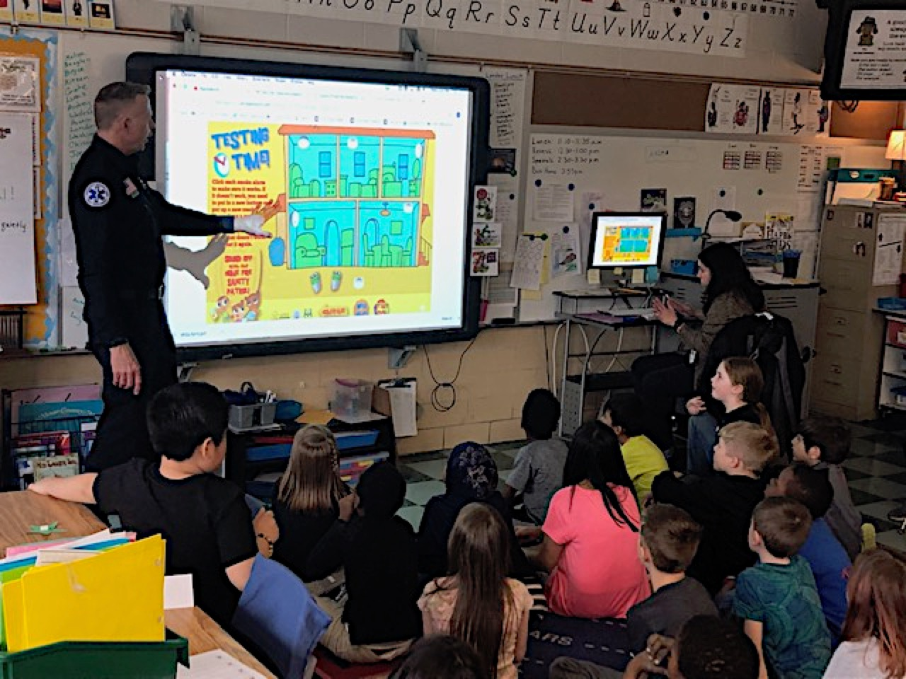
Firefighter Visits and
Classroom Activities a Hit!
© 2026 MPHI. Sound Off with the Home Fire Safety Patrol made possible by funding from the USDHS/FEMA, Award No. EMW-2024-FP-00140, with generous support from First Alert.
Notes:
Firefighters and teachers present Sound Off lessons, activities, and videos in a fun and interactive way. This firefighter is using the Sound Off digital whiteboard activity to teach children about smoke alarm sounds, where smoke alarms should be located in a home, and the importance of escape planning and having a fire drill at least twice a year to practice the plan and help keep families safe from fire.
Presenter Note: Emphasize that having firefighters in the classroom, together with the Sound Off program’s effective, interactive teaching methods, keeps children engaged and interested.

Slide 7
© 2026 MPHI. Sound Off with the Home Fire Safety Patrol made possible by funding from the USDHS/FEMA, Award No. EMW-2024-FP-00140, with generous support from First Alert.
Notes:
Sound Off also has an App you can download to your phone or tablet from the App Store or Google Play. The App lets you and your children play three fun games that illustrate the three key Sound Off lessons – smoke alarm sounds, finding home fire dangers in a drawing, and making a plan to escape the house if there’s a fire. The App makes the smoke alarm sounds, which reinforces the classroom lessons. The App also includes the storybook and four videos that support the program lessons that you can watch at home with your children.
Presenter Note: This is is a useful tool to use with parents/caregivers and all adults during home visits. The Sound Off App is available with English and Spanish audio.

Slide 8

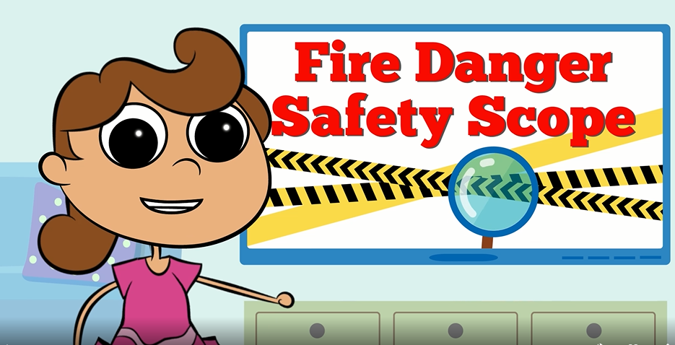
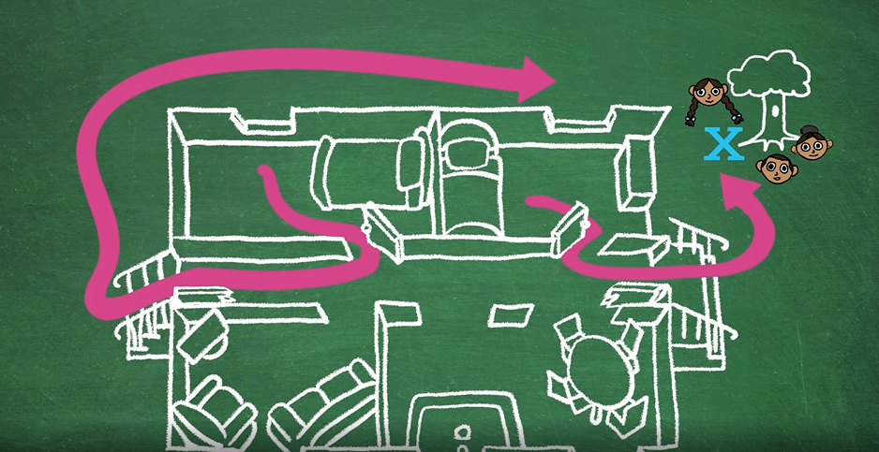
Sound Off Videos
Safety Sounds!
Home Fire Dangers
Home Fire Escape Map
Home Fire Drills
© 2026 MPHI. Sound Off with the Home Fire Safety Patrol made possible by funding from the USDHS/FEMA, Award No. EMW-2024-FP-00140, with generous support from First Alert.
Notes:
Sound Off now has four short videos in English and Spanish that you and your children can watch together. The videos reinforce the topics covered in the activity sheets:
-Safety Sounds!
-Home Fire Dangers
-Home Fire Escape Map – making a plan and having a home fire drill
-Home Fire Drills
Families can view the videos at ymiclassroom.com/soundoffathome
Presenter Note: Families can watch the videos after their children complete the activities so children can share what they learned with their families.

Slide 9
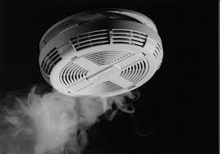
Smoke Alarm Basics
(Where there is love, there are smoke alarms.)
© 2026 MPHI. Sound Off with the Home Fire Safety Patrol made possible by funding from the USDHS/FEMA, Award No. EMW-2024-FP-00140, with generous support from First Alert.
Notes:
This next section will provide you with all the information about smoke alarms that is taught in the Sound Off program.
It is important for all children and adults to recognize the different sounds a smoke alarm might make so you can take action quickly to keep your family safe from fire.
Presenter Note: This is an introduction to cover slides #9-20.

Slide 10

Smoke Alarm Basics
What’s that sound?
Smoke alarms make a loud noise to
warn you when there is smoke in
your home.
When smoke gets into the alarm, it SOUNDS OFF for safety – Beep-Beep-Beep.
© 2026 MPHI. Sound Off with the Home Fire Safety Patrol made possible by funding from the USDHS/FEMA, Award No. EMW-2024-FP-00140, with generous support from First Alert.
Notes:
(Click the BEEP-BEEP-BEEP graphic to let the audience hear the sound of a smoke alarm.)
Smoke alarms make a loud noise to warn you when there is smoke in your home. When smoke gets into the alarm, it SOUNDS OFF for safety –
Beep-Beep-Beep…Beep-Beep-Beep.
Presenter Note: Introduces the function and purpose of smoke alarms.

Slide 11
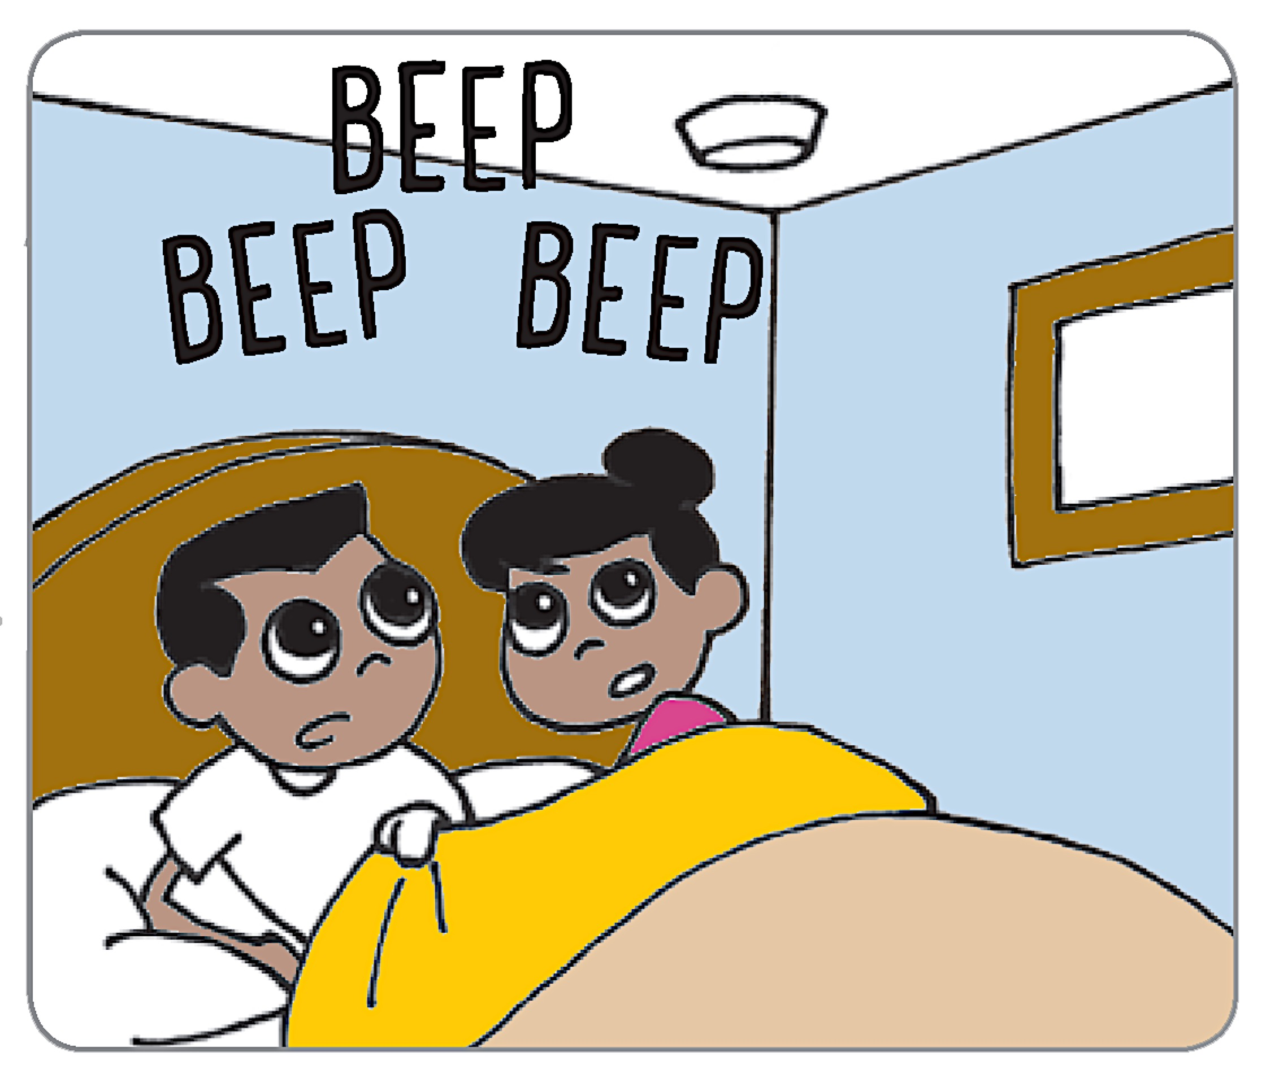
Smoke Alarm Basics
Why are smoke alarms important?
Smoke alarms can give you
time to get out when there
is a fire in your home.
Smoke alarms SOUND OFF
when there is smoke, so
you can escape the fire.
© 2026 MPHI. Sound Off with the Home Fire Safety Patrol made possible by funding from the USDHS/FEMA, Award No. EMW-2024-FP-00140, with generous support from First Alert.
Notes:
Smoke alarms can give you time to get out when there’s a fire in your home.
Smoke alarms SOUND OFF when there’s smoke, so you can escape the fire.
Smoke from a fire is very dangerous – there are poisons in it that can put you into a deeper sleep. This poison smoke can make you very sick or even kill you. That is why you need smoke alarms to wake you up. Also, fire grows and spreads very fast. You may have only 2 minutes to wake up, get to your kids and others who may need help, and get everyone to a safe meeting place outside.
Presenter Note: There will be more discussion about smoke alarms and home escape in Slides #25-31.

Slide 12
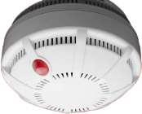

Smoke Alarm Basics
Why do smoke alarms
belong on the ceiling?
Smoke rises toward the ceiling.
Another good spot is high up on
the wall.
© 2026 MPHI. Sound Off with the Home Fire Safety Patrol made possible by funding from the USDHS/FEMA, Award No. EMW-2024-FP-00140, with generous support from First Alert.
Notes:
Smoke rises toward the ceiling in a fire. Smoke alarms on the ceiling or high up on the wall are where the smoke travels first. This makes the smoke alarm sound. It gives you an early warning to escape.

Slide 13

Smoke Alarm Basics
Is one smoke alarm enough
to keep you safe? NO!
You need smoke alarms
In or near all your bedrooms and sleeping areas to wake you up in case a fire starts while you are sleeping.
© 2026 MPHI. Sound Off with the Home Fire Safety Patrol made possible by funding from the USDHS/FEMA, Award No. EMW-2024-FP-00140, with generous support from First Alert.
Notes:
The answer is NO!
You need smoke alarms in or near all your bedrooms and any other places where people sleep.
Most house fires happen between midnight and 6 am. You need smoke alarms to wake you up in case a fire happens while you are sleeping.

Slide 14
Smoke Alarm Basics
Is one smoke alarm enough
to keep you safe? NO!
You need smoke alarms
On every floor or level of your
home – even the basement –
so you can hear the alarm no matter where a fire starts.
© 2026 MPHI. Sound Off with the Home Fire Safety Patrol made possible by funding from the USDHS/FEMA, Award No. EMW-2024-FP-00140, with generous support from First Alert.
Notes:
You also need at least one smoke alarm on every floor or level of your home – even the basement.
That way you will be able to hear an alarm no matter where the fire gets started.

Slide 15
Smoke Alarm Basics
BUT do not put a smoke alarm in
the kitchen or a bathroom.
Steam from cooking or the shower can
make a smoke alarm Sound Off when
there is no fire.
© 2026 MPHI. Sound Off with the Home Fire Safety Patrol made possible by funding from the USDHS/FEMA, Award No. EMW-2024-FP-00140, with generous support from First Alert.
Notes:
Don’t put a smoke alarm in or near your kitchen or bathroom. Steam from things like cooking or from the shower can make a smoke alarm Sound Off when there is no fire.
Important note to the fire service: new smoke alarm standards — You do not need to try to explain this to the public but we want you to be aware. Recent changes to the UL Standard for smoke alarms, UL 217, have caused manufacturers to develop next-generation models of smoke alarms. Several are already on the market. These next-generation models are more sophisticated — they can tell the difference between smoke from a real fire and smoke and vapors from cooking and steam. The goal is to reduce or eliminate the problem of unwanted alarms that lead people to disable their smoke alarms when they fry a hamburger or take a shower and the alarm goes off. As of June of 2022, all smoke alarms installed in homes are required to meet the new standard.
There is a normal “sell off” period that allows retailers to offer older edition alarms for sale to deplete their inventory. These alarms are effective – they just lack the improved nuisance-resistant features. Photoelectric alarms are less likely to cause nuisance alarms, so place these in positions near kitchens and bathrooms, at least 10 feet away.

Slide 16

Smoke Alarm Basics
What’s that sound?
That is a smoke alarm that needs a new battery or a whole new alarm.
When you hear the alarm chirp, you need to replace the battery or get a new alarm right away to keep your family safe.
© 2026 MPHI. Sound Off with the Home Fire Safety Patrol made possible by funding from the USDHS/FEMA, Award No. EMW-2024-FP-00140, with generous support from First Alert.
Notes:
(Click the bird graphic to let the audience hear the chirp sound of a smoke alarm.)
Smoke alarms that need a new battery or are getting too old to work well will chirp (like a bird).
When you hear that chirp sound, you need to replace the battery right away if the alarm uses a battery, or you need to replace the whole alarm with a new one to keep your family safe.
If the alarm uses a replaceable battery, push the button after you replace the battery to test the alarm to be sure it’s working. If you don’t hear the Beep-Beep-Beep…Beep-Beep-Beep sound, then you might need to try another battery or replace the smoke alarm with a new one.

Slide 17
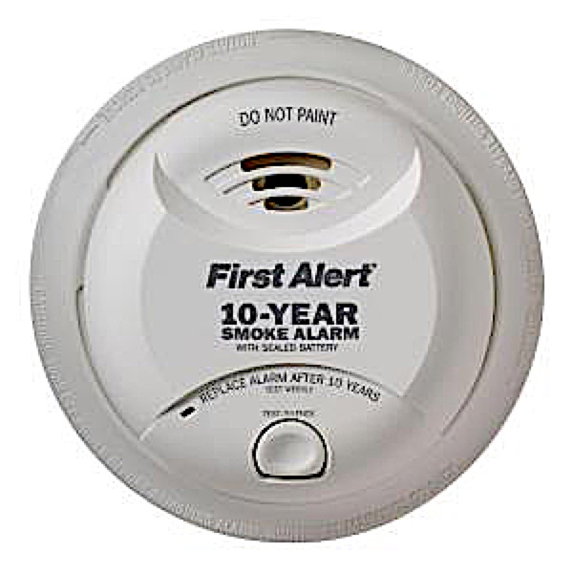
Smoke Alarm Basics
Some smoke alarms are different…
Smoke alarms with long-life
batteries cannot be opened to
replace the batteries.
When these smoke alarms make
that chirp sound, you need to replace the smoke alarm with a new one.
© 2026 MPHI. Sound Off with the Home Fire Safety Patrol made possible by funding from the USDHS/FEMA, Award No. EMW-2024-FP-00140, with generous support from First Alert.
Notes:
There are smoke alarms with long-life batteries that cannot be opened to replace the battery. These alarms are designed to last between 7 and 10 years without changing the battery.
When these smoke alarms make the chirp sound, you need to replace the whole smoke alarm.

Slide 18
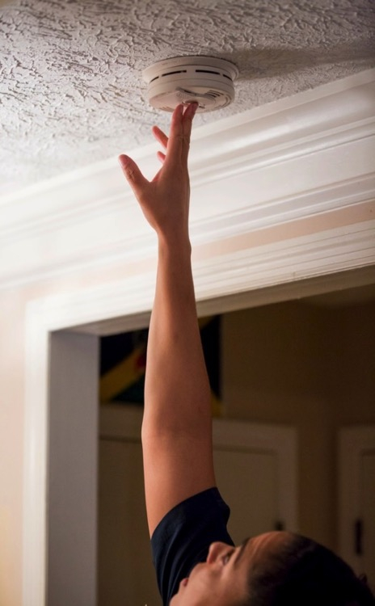
Starting a Home Fire Safety Patrol
Test your smoke alarms every month – don’t wait for the chirp sound!
Push the test button on every smoke alarm in your home.
You should hear Beep-Beep-Beep… Beep-Beep-Beep.
© 2026 MPHI. Sound Off with the Home Fire Safety Patrol made possible by funding from the USDHS/FEMA, Award No. EMW-2024-FP-00140, with generous support from First Alert.
Notes:
Activity One of the Sound Off program has an important homework assignment. It asks children to go on a home fire safety patrol with a grown-up to find and test all the smoke alarms in their home. The children also check to see that there is a smoke alarm in or near every bedroom and sleeping area, including hallways. And they check to be sure there is a smoke alarm on every floor or level of the home.
The grown-up tests each smoke alarm by using a ladder or a broom handle to reach up and push the test button on each alarm to see that it works. You should hear
Beep-Beep-Beep…Beep-Beep-Beep.
Presenter Note: This leads into the discussion of the first Sound Off lesson and the role of parents/caregivers in testing smoke alarms.

Slide 19
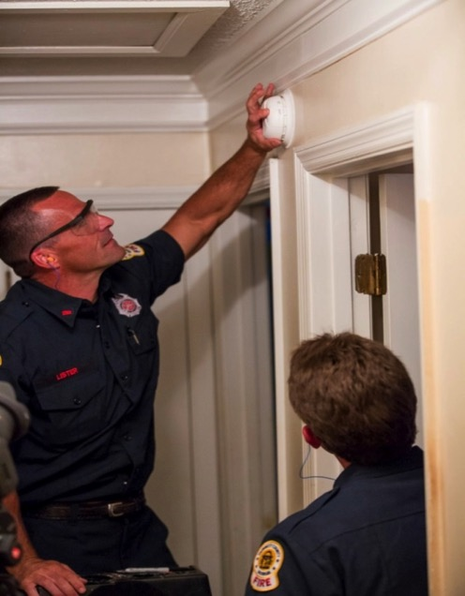
Starting a Home Fire Safety Patrol
If you do not hear that sound, put in new batteries or put up a new smoke alarm.
Push the test button again.
If the smoke alarm still does not work, get a new smoke alarm right away!
© 2026 MPHI. Sound Off with the Home Fire Safety Patrol made possible by funding from the USDHS/FEMA, Award No. EMW-2024-FP-00140, with generous support from First Alert.
Notes:
If you do not hear the beep, it means you need to put in a new battery or put up a new smoke alarm.
Push the test button again after replacing the battery.
If the smoke alarm still does not work, get a new smoke alarm right away! The fire department can make a visit to install new alarms in homes that need them.
Call us at [give the phone number for your community] to ask for help with your smoke alarms. Do it right away!

Slide 20
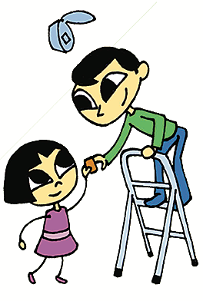
Starting a Home Fire Safety Patrol
Change all smoke alarm batteries once a year.
Replace all old smoke alarms
every 7-10 years.
© 2026 MPHI. Sound Off with the Home Fire Safety Patrol made possible by funding from the USDHS/FEMA, Award No. EMW-2024-FP-00140, with generous support from First Alert.
Notes:
We all know the chirp sound of a smoke alarm is very annoying. And it usually happens when you are sound asleep. You can avoid this by replacing the batteries in your smoke alarms before they chirp. If you have alarms with replaceable batteries, put in new batteries once a year. Test all your smoke alarms once a month to make sure they are working to keep you and your family safe.
One last thing: smoke alarms do not last forever. Replace all old smoke alarms every 7-10 years.

Slide 21
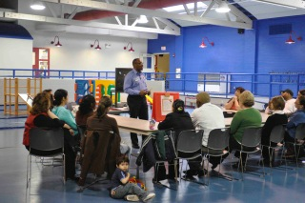
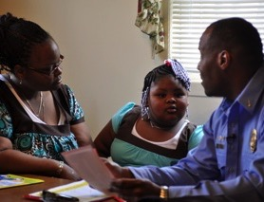
Reaching Kids and Caregivers
© 2026 MPHI. Sound Off with the Home Fire Safety Patrol made possible by funding from the USDHS/FEMA, Award No. EMW-2024-FP-00140, with generous support from First Alert.
Notes:
The goal of the “Sound Off with the Home Fire Safety Patrol” program is to reach all kids, caregivers, and adults in the community with the lifesaving information and practices that will keep them safe from fire.

Slide 22

ID Homes without Smoke Alarms
© 2026 MPHI. Sound Off with the Home Fire Safety Patrol made possible by funding from the USDHS/FEMA, Award No. EMW-2024-FP-00140, with generous support from First Alert.
Notes:
By working together with the schools, we can identify homes in every community that do not have any smoke alarms…

Slide 23
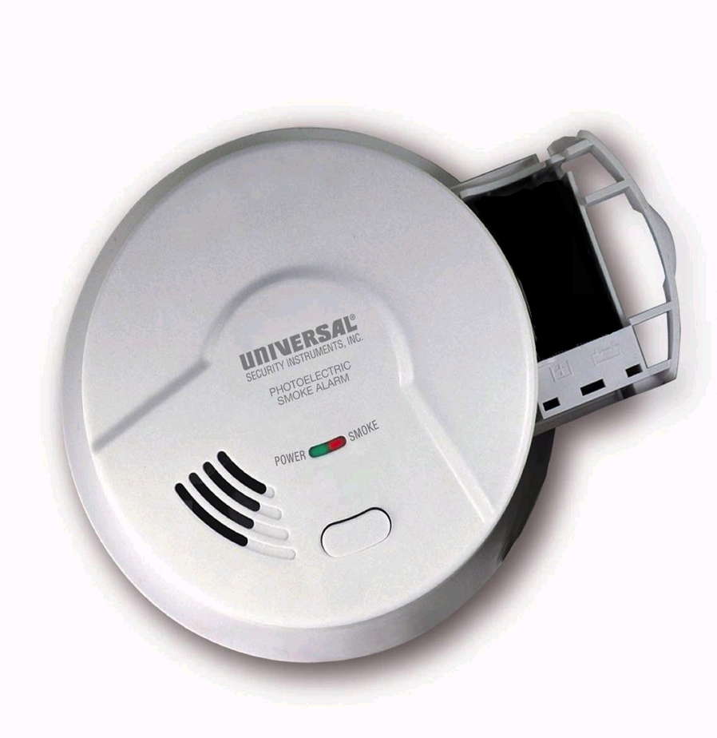
Dead and Missing Smoke Alarms
© 2026 MPHI. Sound Off with the Home Fire Safety Patrol made possible by funding from the USDHS/FEMA, Award No. EMW-2024-FP-00140, with generous support from First Alert.
Notes:
…and those homes with dead smoke alarms or missing smoke alarms.

Slide 24
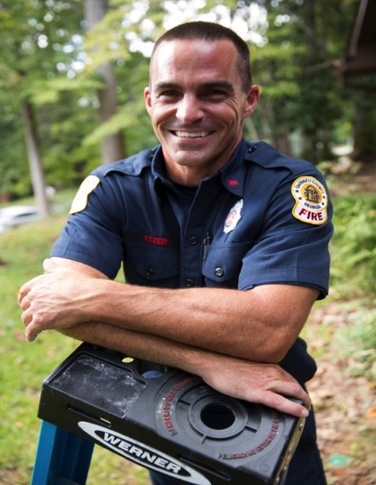
Ask a Firefighter for Help…
If your home does not have smoke alarms, your local fire department may be able to help you.
Firefighters want every family to have working smoke alarms.
© 2026 MPHI. Sound Off with the Home Fire Safety Patrol made possible by funding from the USDHS/FEMA, Award No. EMW-2024-FP-00140, with generous support from First Alert.
Notes:
If your home doesn’t have working smoke alarms, call us at [give the phone number for your community]. Or send us an email. We will help you.
Presenter Note: Provide information as to how the fire department can assist in providing and installing smoke alarms through home visits.

Slide 25

Make a Home Fire Escape Plan
© 2026 MPHI. Sound Off with the Home Fire Safety Patrol made possible by funding from the USDHS/FEMA, Award No. EMW-2024-FP-00140, with generous support from First Alert.
Notes:
So now we know that working smoke alarms are very important to helping you and your loved ones stay safe from fire. But smoke alarms alone cannot save your life. You need to know just what to do when the alarm sounds.
These next slides will review this important information, which is covered in Activity Three in the Sound Off program.
Presenter Note: This is an introduction to review home fire escape planning and practice with an emphasis on the role of parents and caregivers.

Slide 26
Make a Home Fire Escape Plan
Firefighters want every family to have a home fire escape plan.
Map two ways to get out of every room in your home.
© 2026 MPHI. Sound Off with the Home Fire Safety Patrol made possible by funding from the USDHS/FEMA, Award No. EMW-2024-FP-00140, with generous support from First Alert.
Notes:
As we previously discussed, smoke alarms give children and families in our community an early warning in case of fire.
Knowing what to do when the smoke alarm Sounds Off begins with having and practicing a home fire escape plan.
To begin this process, in Sound Off Activity Three, children are instructed to draw a map of their home that shows two ways out of every room in case of a home fire.

Slide 27

Make a Home Fire Escape Plan
Mark an outside meeting place on your map where everyone goes after they get outside.
Then call 9-1-1.
© 2026 MPHI. Sound Off with the Home Fire Safety Patrol made possible by funding from the USDHS/FEMA, Award No. EMW-2024-FP-00140, with generous support from First Alert.
Notes:
Your home fire escape map should also show an outside family meeting place. Choose a safe place in front of your home so the firefighters can see you when they arrive. It might be a tree or a mailbox or a neighbor’s driveway. Teach children to go to this place and wait there – do not go back inside for any reason.
Too many people have died going back inside a burning home to rescue someone when that person is already out. Having a meeting place where everyone gathers can help prevent this mistake. Remember, the rule is: once you get outside, stay outside. Call 9-1-1 immediately and give them your address. Firefighters have the training and equipment to rescue anyone still inside.
Presenter Note: Emphasize that all family members need to know the family meeting place.

Slide 28
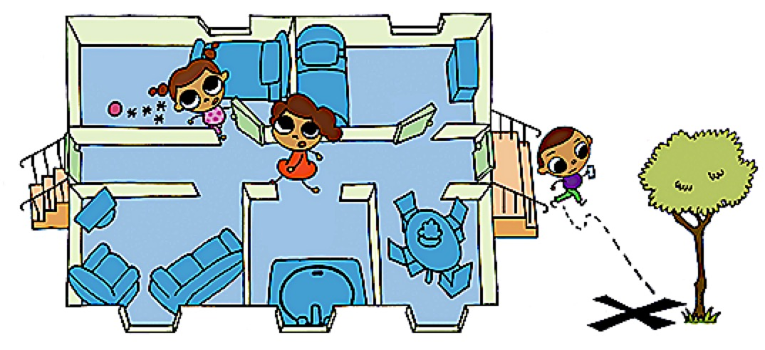
Practice Your Home Fire Escape Plan
Have a fire drill to practice your escape plan with the entire family at least twice a year so that everyone knows what to do in case a fire happens in your home.
Time yourself. You should be able to get
outside in two minutes or less.
© 2026 MPHI. Sound Off with the Home Fire Safety Patrol made possible by funding from the USDHS/FEMA, Award No. EMW-2024-FP-00140, with generous support from First Alert.
Notes:
Practice your home fire escape plan with a family fire drill at least twice a year to remind everyone of what they should do to stay safe if a fire starts in your home. Use Activity 4, the take-home activity, with a checklist to help you plan and practice a home fire drill.
Practice makes perfect. Knowing that everyone in your home knows exactly what to do and where to meet means safety for everyone and peace of mind for parents and caregivers.
But here is something very important you should know. Children sleep more deeply than grown-ups. Research has shown that children often do not hear the smoke alarm when they are asleep and they might hide under a bed or in a closet if they are frightened. You and the other grown-ups in your home should plan to go to each child to help them wake up and get outside.
Make sure that you time your home escape practice. You should be able to get outside in two minutes or less, before the heat and smoke become difficult and deadly.
After your children have learned and practiced their escape plan during the day, tell them you will try one at night to practice when it is dark. Keep a flashlight by your bed to help get everyone out safely.

Slide 29
Practice Your Home Fire Escape Plan
Make sure that all windows and doors open easily to get out fast.
Use windows only in a real emergency to
prevent injuries.
© 2026 MPHI. Sound Off with the Home Fire Safety Patrol made possible by funding from the USDHS/FEMA, Award No. EMW-2024-FP-00140, with generous support from First Alert.
Notes:
You need to be sure that all windows and doors along your escape paths open easily so you can get out fast. Windows that are painted shut or blocked by fixed security bars (no quick release from the inside) or window air conditioners cannot be used as a second path to safety in a home fire.
To prevent injuries, children and adults should only use windows in a real emergency when the primary exit is blocked by fire or smoke.

Slide 30
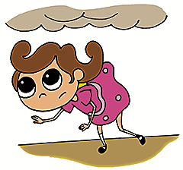
Home Fire Escape Rules
Get Low and Go if you have to escape through smoke.
Smoke rises to the ceiling, so stay close to the floor where the air is cleaner.
© 2026 MPHI. Sound Off with the Home Fire Safety Patrol made possible by funding from the USDHS/FEMA, Award No. EMW-2024-FP-00140, with generous support from First Alert.
Notes:
GET LOW AND GO is what children and adults need to do when there is smoke from a fire. Smoke rises to the ceiling and contains many toxins that can affect thinking and breathing. The air near the floor is cleaner and crouching low, under the smoke, will help you escape quickly to the outside.
If you are sleeping with your door closed and hear the smoke alarm SOUND OFF, crack the door open to see if fire or smoke is blocking your exit. If you see smoke or fire, close the door and use your secondary (window) exit. If you cannot go out the window, wait by the window where the firefighters can see you.
If your secondary exit is on an upper floor, where you could be seriously injured by exiting:
- Stay calm.
- Crack the window open and hang a blanket or sheet out to alert firefighters of your location. Then close the window to keep smoke from coming in.
- Turn on the light in the room, or use a flashlight to signal from the window.
- Block the crack at the bottom of the door with towels, sheets, or whatever you have available to prevent smoke from entering the room.
- Call 9-1-1 and wait for the fire department to arrive.
Presenter Note: Although all of the above information is not included in the Sound Off lessons for grades 2 and 3, it is valuable for adult audiences.

Slide 31

Home Fire Escape Rules
Close all doors behind you as you escape to prevent the fire from spreading.
© 2026 MPHI. Sound Off with the Home Fire Safety Patrol made possible by funding from the USDHS/FEMA, Award No. EMW-2024-FP-00140, with generous support from First Alert.
Notes:
Close all doors behind you as you escape to prevent the fire from spreading.

Slide 32
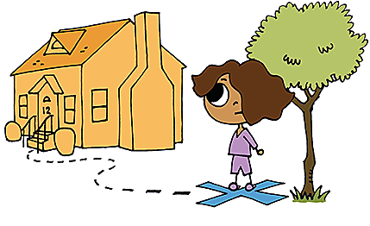
Home Fire Escape Rules
Go to your outside meeting place and call 9-1-1. Tell them your street address.
Stay outside – Never go back into a burning building.
© 2026 MPHI. Sound Off with the Home Fire Safety Patrol made possible by funding from the USDHS/FEMA, Award No. EMW-2024-FP-00140, with generous support from First Alert.
Notes:
We’ve already discussed the importance of having an outside meeting place as part of your home fire escape plan.
It is also important to repeat and emphasize to children that once outside:
- Go to your meeting place,
- Call 9-1-1,
- Know and tell them your address, and
- NEVER go back into a burning building.

Slide 33
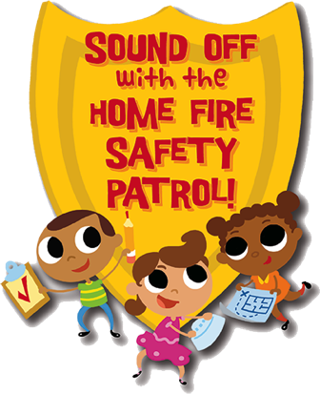
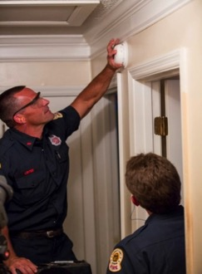
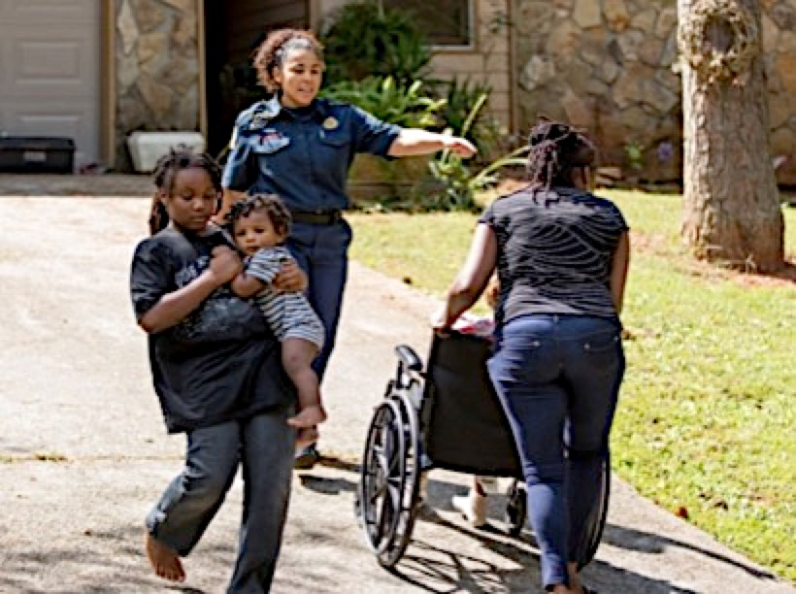

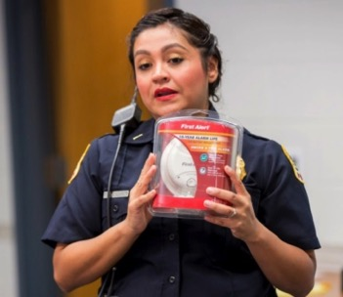
Partners in Home Fire Safety
Schools, Fire Departments
Parents, Caregivers, Community Partners
© 2026 MPHI. Sound Off with the Home Fire Safety Patrol made possible by funding from the USDHS/FEMA, Award No. EMW-2024-FP-00140, with generous support from First Alert.
Notes:
The “Sound Off with the Home Fire Safety Patrol” program works as a partnership with the fire department, our local schools, parents, caregivers, and all adults in our community to keep everyone safe from fire.
Presenter Note: Focus on the partnerships that participate in your local/state Sound Off program.

Slide 34

Sound Off with the Home Fire Safety Patrol
CENTER FOR NATIONAL
PREVENTION INITIATIVES
© 2026 MPHI. Sound Off with the Home Fire Safety Patrol made possible by funding from the USDHS/FEMA, Award No. EMW-2024-FP-00140, with generous support from First Alert.
Notes:
The Sound Off program is funded by a grant from the US Department of Homeland Security and FEMA. We thank them for this support. We also thank the National Center for Prevention Initiatives at the Michigan Public Health Institute for overseeing this grant.

Slide 35

Sound Off with the Home Fire Safety Patrol Developers
© 2026 MPHI. Sound Off with the Home Fire Safety Patrol made possible by funding from the USDHS/FEMA, Award No. EMW-2024-FP-00140, with generous support from First Alert.
Notes:
Thanks to the professional curriculum developers at Young Minds Inspired who worked with national fire safety experts to design and test all of the materials for the “Sound Off with the Home Fire Safety Patrol” program…

Slide 36


Thanks to Our Sponsors
© 2026 MPHI. Sound Off with the Home Fire Safety Patrol made possible by funding from the USDHS/FEMA, Award No. EMW-2024-FP-00140, with generous support from First Alert.
Notes:
Thanks to our other sponsors: FEMA’s Assistance to Firefighters Grant Program and First Alert.

Slide 37


Notes:
And finally, thank you for taking the time to be here today and for your interest in keeping children and everyone in our community safe from fire using the “Sound Off with the Fire Safety Patrol” program.

